Slide 1
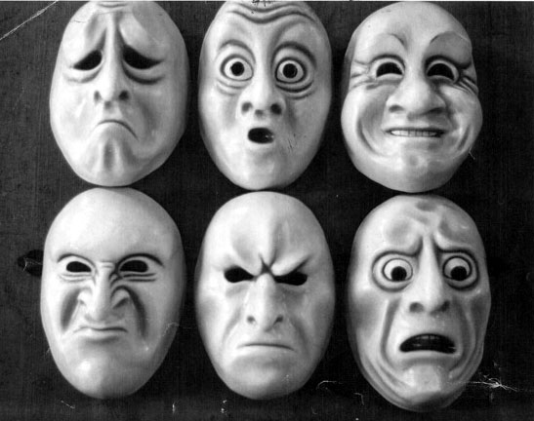
EMOTION

Slide 2
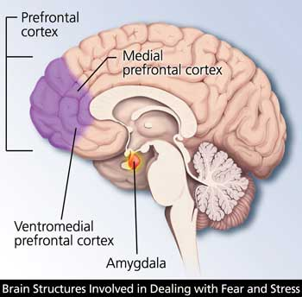
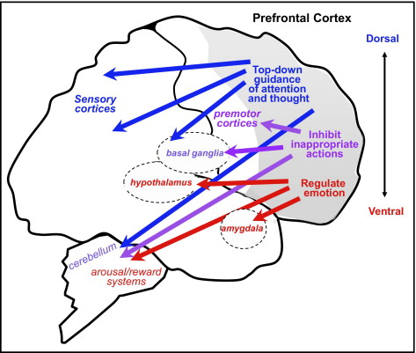

Slide 3
The Measurement of Emotion
Self-Report
Behavioral Observation
Physiological Measures
Galvanic Skin Response (GSR)
EKG
BMR (oxygen consumption)
EMG (muscle tension)

Slide 4
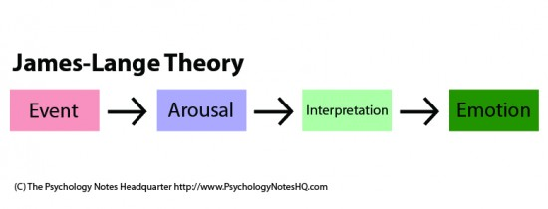
James-Lange Theory of Emotion

Slide 5
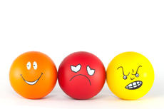
Self-Perception of Emotional State

Slide 6
Schachter & Singer’s Cognitive-Labeling Theory of Emotion
Given a state of physiological arousal for which an individual has no immediate explanation, he/she will label feelings according to the cognitions available
Given a state of physiological arousal PLUS an appropriate explanation for the arousal – no search for a label takes place.
Given the same cognitive circumstances, individuals react emotionally only to the extent that they are experiencing arousal.

