Slide 1
Obedience

Slide 2
The Milgram Obedience Experiments
Stanley Milgram

Slide 3
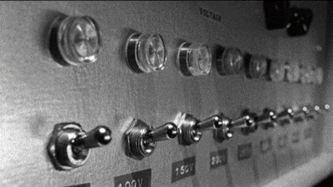
The Milgram Obedience Experiments

Slide 4
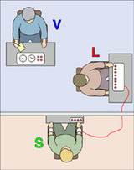
The Milgram Obedience Experiments

