Slide 1
Some Psychological Disorders Due to Brain Damage

Slide 2
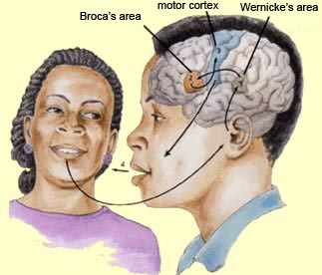
Language Areas of Brain

Slide 3
Aphasia - Language Problems
Broca’s Aphasia (Speaking)
Wernicke’s Aphasia (Comprehension)
Alexia (Reading)
Agraphia (Writing)
Anomia (Naming)
Acalculia (Math Operations)

Slide 4
Agnosia - Recognition Problems
Object Agnosia
Amusia (Tones)
Prosopagnosia (Faces)
Movement Agnosia
Astereognosia (Touch)
Neglect Syndrome

Slide 5
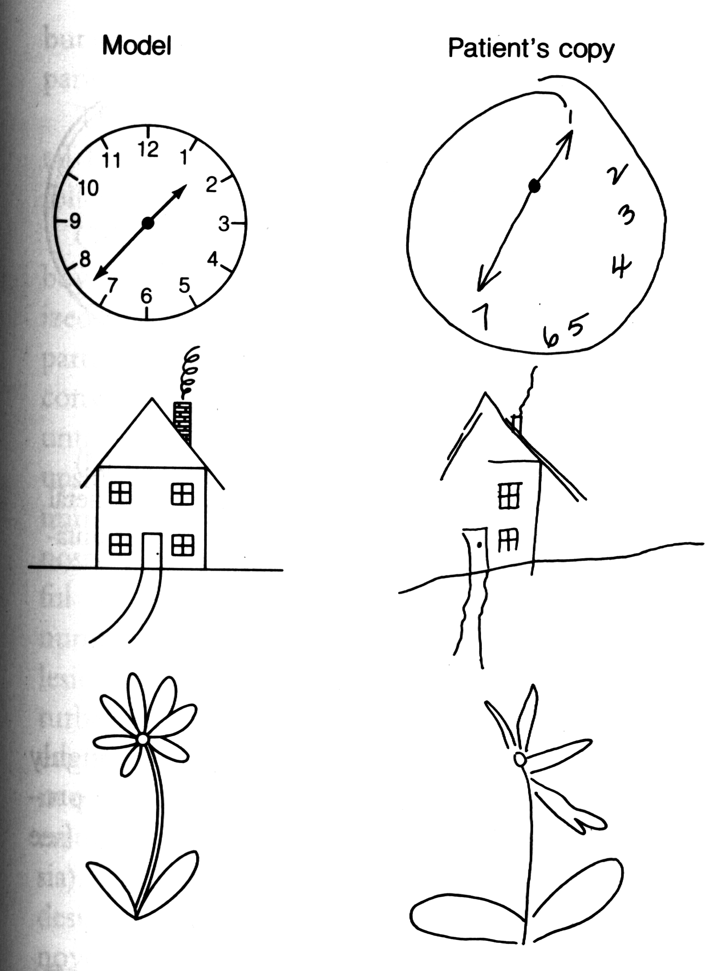

Slide 6
Kluver-Bucy Syndrome
Hypersexuality
Lack of Emotion
Compulsive Oral Exploration
Psychic Blindness

Slide 7
Milner’s Syndrome & Korsakov’s Syndrome
A Complete Inability to transfer New Information into Long-Term Memory
(Clive Wearing)

