Slide 1
Family Violence
It is a myth that blood-related family members kill each other on a regular basis
Rates of child abuse are 50 to 100 times higher in stepfamilies
You are 11 times more likely to be killed by a non-kin family member
Big difference in murder style between stepfathers and biological fathers

Slide 2
Family Violence
Reproductive value of child & parents’ life circumstances are the best predictors of violence
Children killed by parents usually born to young parents with capacity to produce more
Infants (<1) are more likely to be murdered than older children
Health of infant and circumstances of mother are predictors of neglect, abuse, murder

Slide 3
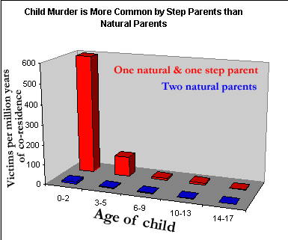
Family Violence

Slide 4
Family Violence
Male violence against spouses is usually triggered by sexual jealousy
Younger wives are at greatest risk
Degree to which biologically related children looked like father correlated with quality of relationship with kids and severity of injuries inflicted on wife
Based on a study of 55 men in a domestic violence treatment program

