Slide 1
Factors Contributing to Prejudice
Strong Stereotypes (High Social Power)
Personality Traits (Authoritarianism, N-App, Hi Social Dominance Orientation)
Religious Involvement
In-Group/Out-Group Distinctions (Social Identity Theory)
Self-esteem derived from group membership
Made stronger via “Terror Management”
In-Group Bias (Group-Serving Bias)
Outgroup Homogeneity Effect
Inter-group Competition for Scarce Resources
Biases in Processing Information
Confirmation Bias (Leading to Illusory Correlations)
Remember Congruent Information Better
We actively seek to confirm ingroup similarity & outgroup dissimilarity
Behavior leading to Self-Fulfilling Prophecies
Scapegoating

Slide 2
How to End Prejudice?
Socialization

Slide 3
Messages in the Media for Children

Slide 4
Children’s Toy Commercials
Rose Petal Cottage
Tiger Joe
Vintage Commercials #1
Vintage Commercials #2

Slide 5
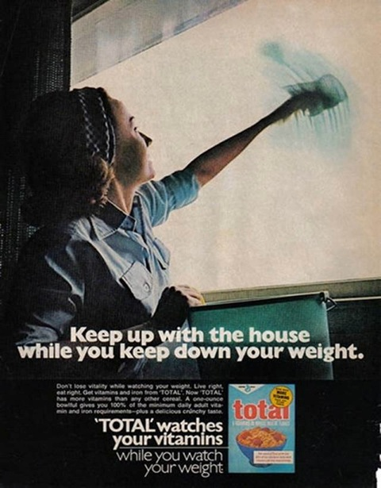

Slide 7
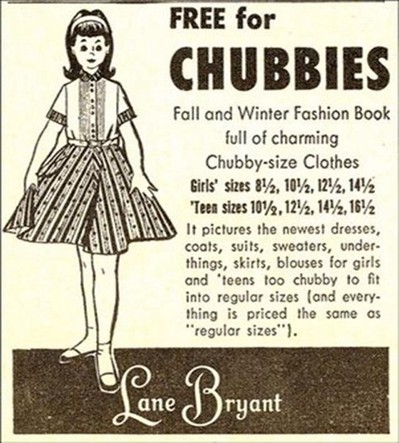

Slide 8
How to End Prejudice?
Socialization
Cultivate Anti-prejudice Social Norms
Remove outgroup cues, reduce “we-they” mentality
Intergroup Contact with the Following Criteria:
Equal Social & Economic Status/Power
Common Goals
Individuals Differing from Stereotype
Informal, Day-to-Day Contact
Social Norms Favoring Equality
*Reduce We-They Mentality; Common goals, overlapping
group membership; remove outgroup cues

