Slide 3
Diffusion of Responsibility
Pluralistic Ignorance
Fear of Looking Foolish in front of others

Slide 4
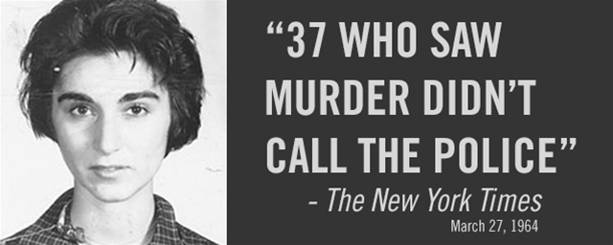
Apathy?
Not a likely explanation

Slide 5
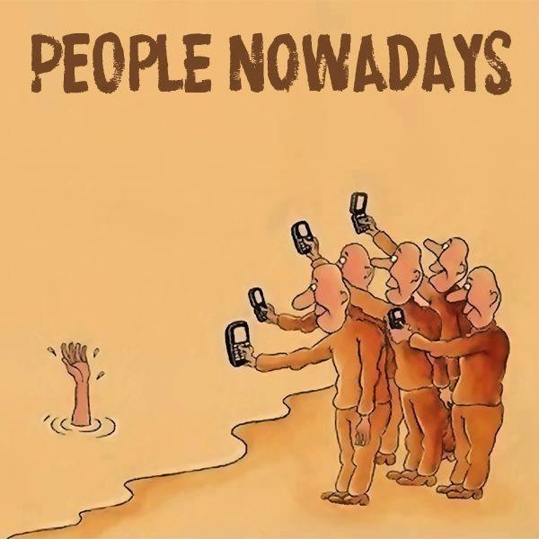

Slide 6
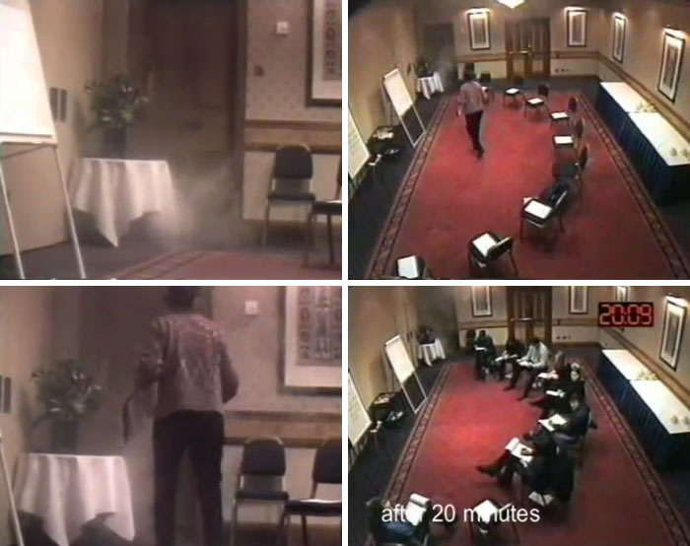
The Smoke-Filled Room Study

Slide 7
“Lady in Distress” Study
Alone = 70%
Two Friends = 70%
2 Naïve Strangers = 40%
With Passive Confederate = 7%

Slide 8
Epileptic Seizure Study: Results
Percent helping
By end of seizure
Percent ever
responding
Average time
of response
GROUP SIZE
2
(Subject + Victim)
100%
85%
52 seconds
3
(Sub. + Victim + Other)
62%
85%
93 seconds
6
(Sub. + Victim + 4 Others)
31%
62%
166 seconds

