Slide 1
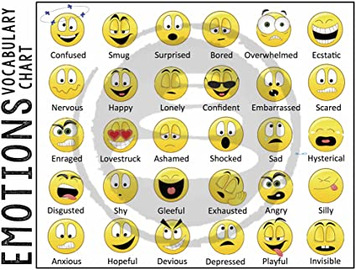
How Many Emotions Are There?

Slide 2
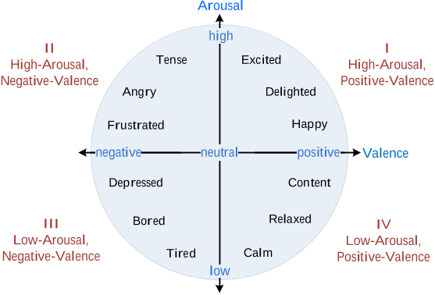
The Circumplex Model of Emotion

Slide 3
The Three-Factor Theory of Emotion (Mehrabian & Russell, 1974, 1976, 1980)
Arousal
Non-Arousal
Pleasure
Non-Pleasure
Dominance
Submissiveness

Slide 4
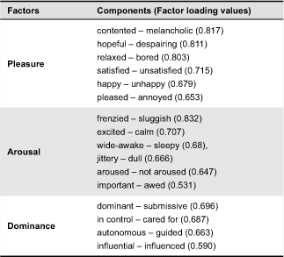
The Three-Factor Theory of Emotion (Mehrabian & Russell, 1974, 1976, 1980)

