Slide 1
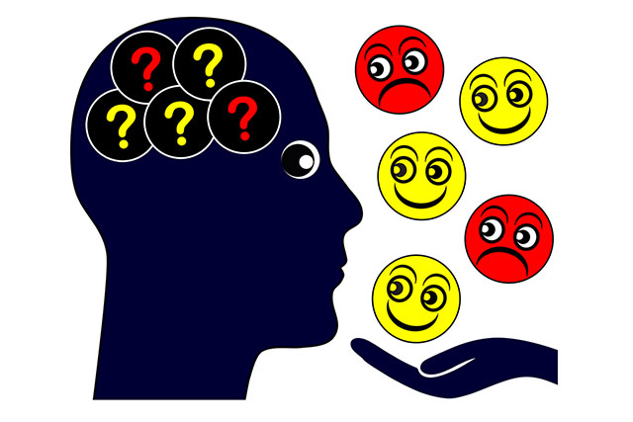
Reading Emotions in other People

Slide 2
How Do We Know that Facial Expressions are Universal and Innate?

Slide 3
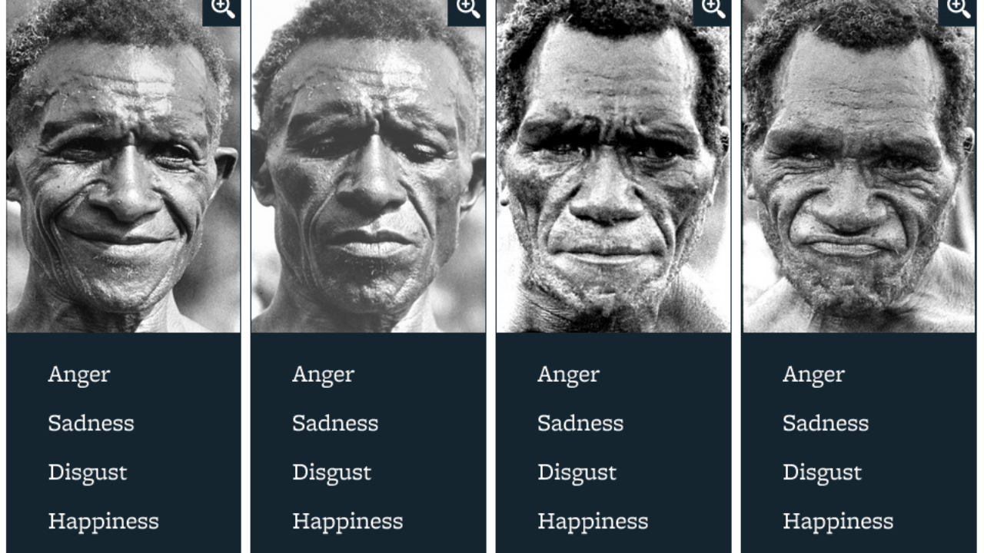
Cross-Cultural Similarity

Slide 4
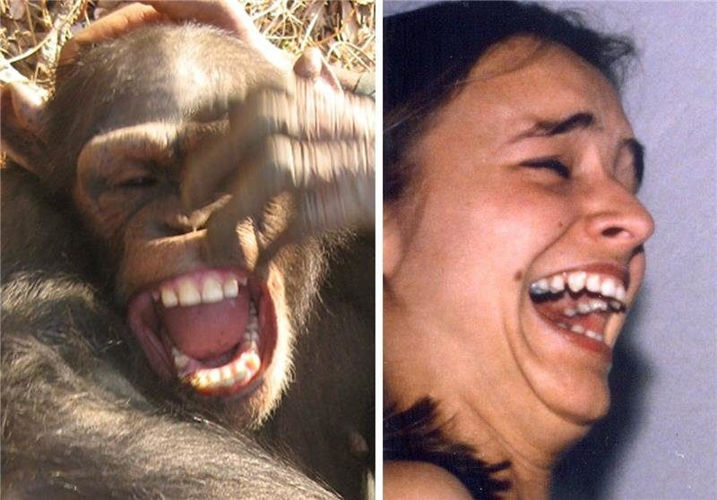
Studies on Non-Human Primates

Slide 5
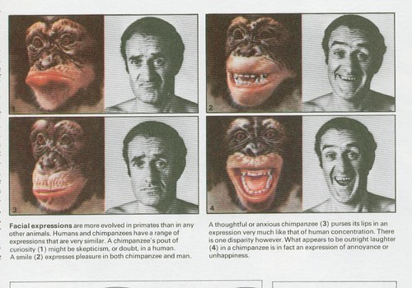
Studies on Non-Human Primates

Slide 6
Studies on Non-Human Primates

Slide 7
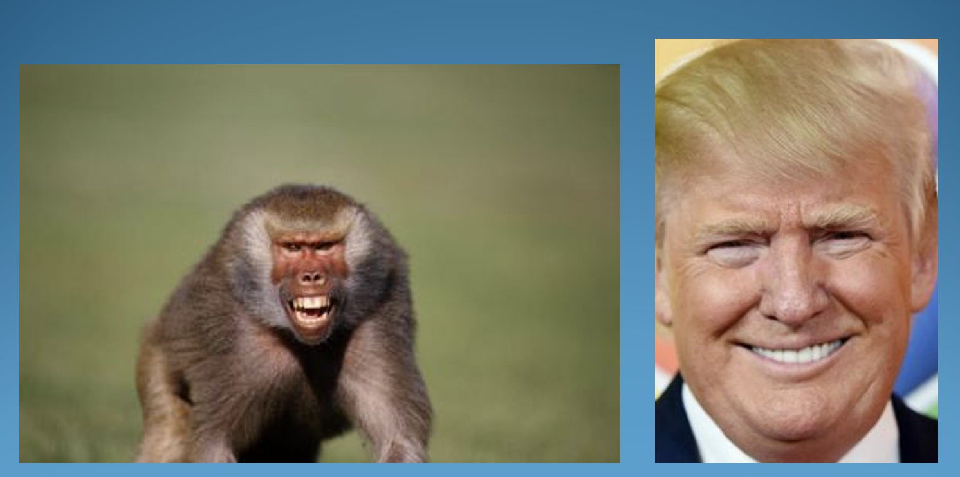
Studies on Non-Human Primates

Slide 8
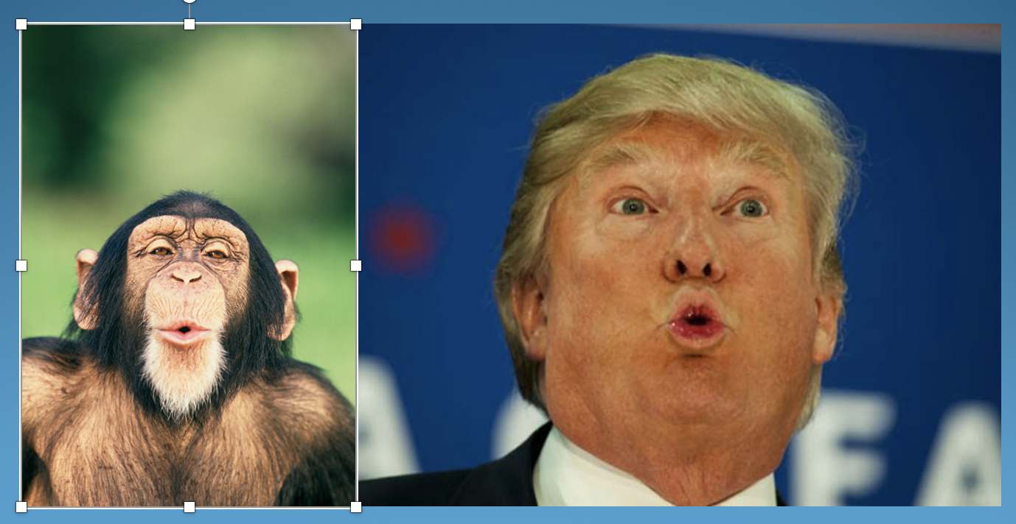
Studies on Non-Human Primates

Slide 9
Studies on Non-Human Primates

Slide 10
Facial Expression in People Born Blind

Slide 11
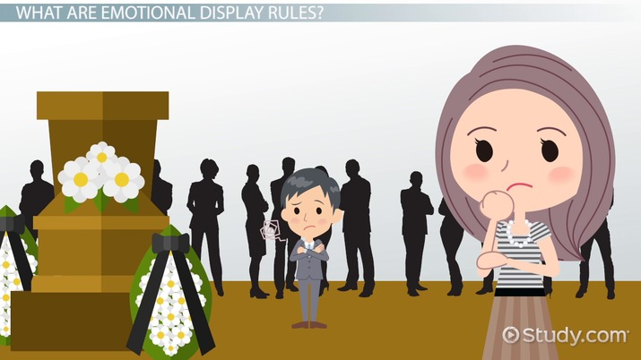
Display Rules

Slide 12
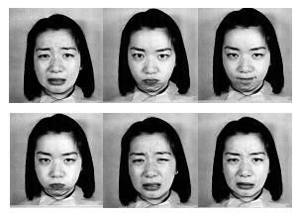
An Example of a “Display Rules” Study: Japanese vs. American Facial Expressions

Slide 13
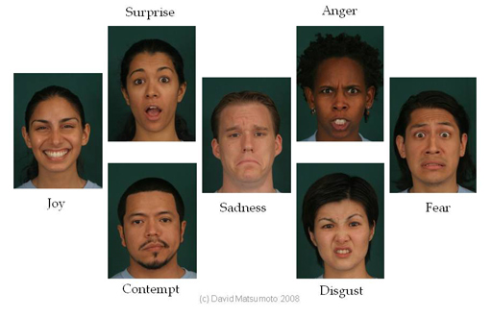
Seven Basic Facial Expressions of Emotion

Slide 14
Basic Facial Expressions of Emotion

Slide 15
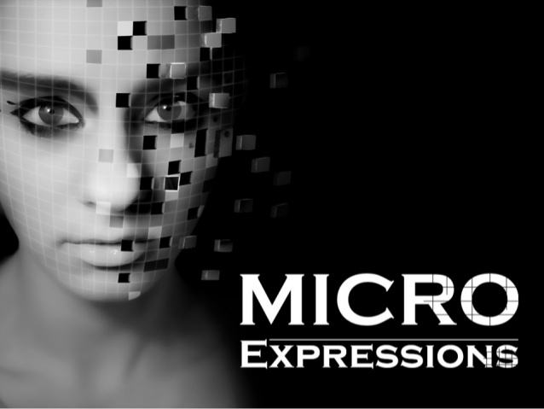

Slide 16
Facial “Management” Techniques
Qualifying
Quickly follow one expression with another
Modulating
Adjust intensity of expression
Falsifying
Outright faking or covering up

