Slide 1
What is a Group? Two or more individuals who -
Have a sense of belonging
Interdependent Fates
Interaction among the members
Shared norms and goals

Slide 2
Group Structure

Slide 3
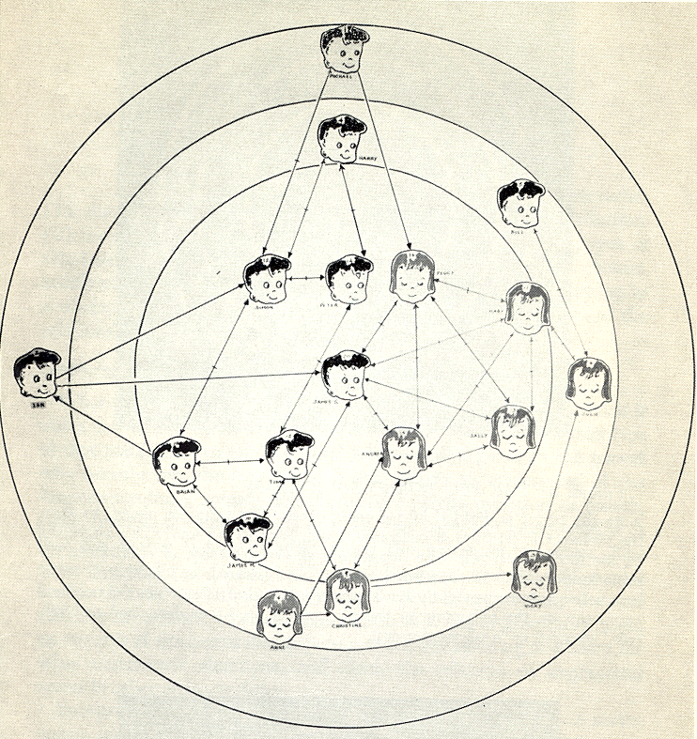
Groups Have Formal & Informal Structures
Sociogram

Slide 4
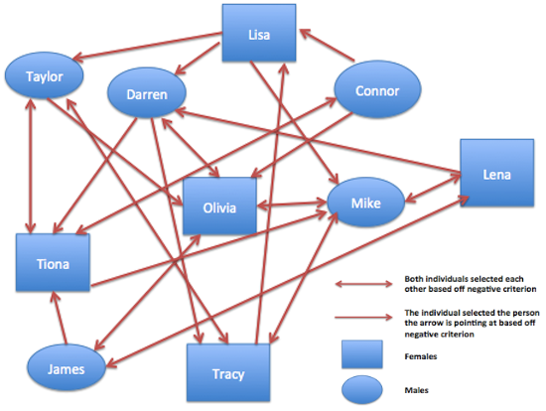
Groups Have Formal & Informal Structures
Sociogram

Slide 5
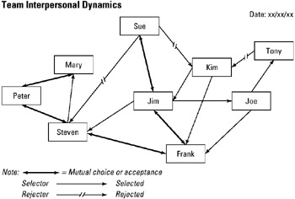
Groups Have Formal & Informal Structures
Sociogram

Slide 6
Group Cohesiveness
Is Increased by
Stability
Homogeneity
Small Size
Isolation or Outside Pressure

Slide 7
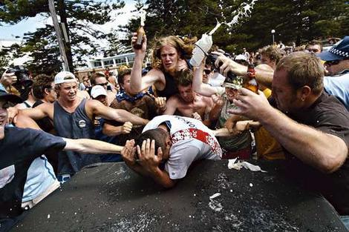
Group Effects on the Individual
Social Facilitation
Social Loafing
Social Compensation
Deindividuation

