Slide 1
Biology of the Brain & Nervous System
The Structure of the Nervous System
Neurons: The building blocks of the nervous system
The Structure & Function of the Brain

Slide 2
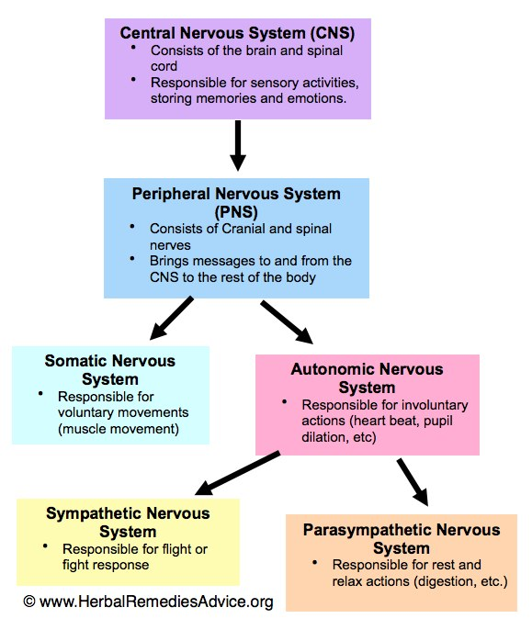
Structure of Nervous System

Slide 3
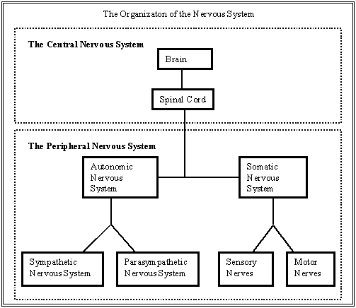
Structure of Nervous System

Slide 4
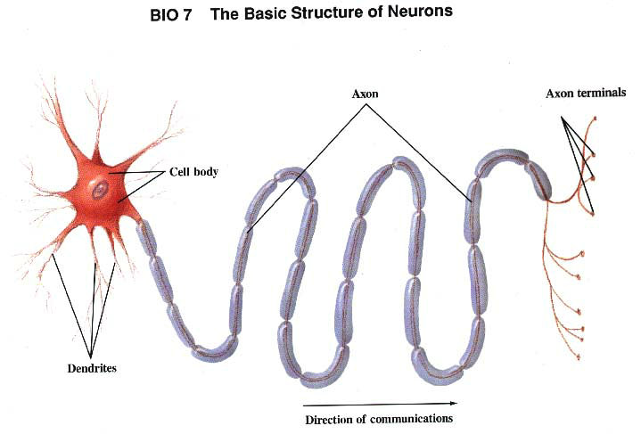

Slide 5
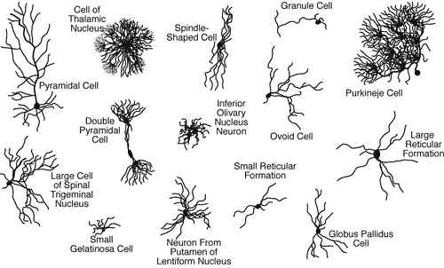
Neurons

Slide 6
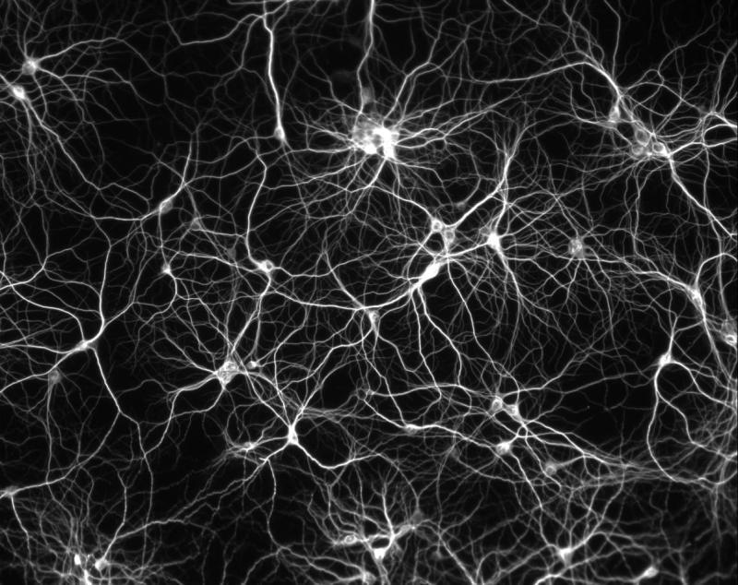
Branching of Neurons

Slide 7
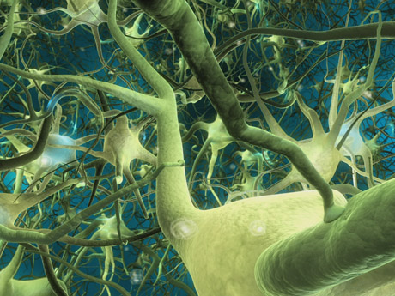
Branching of Neurons

Slide 8
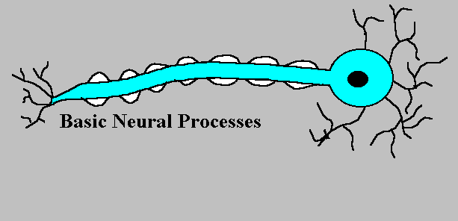
The Action Potential

Slide 9
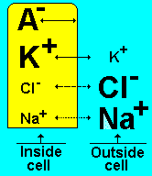
A Neuron at Rest

Slide 10
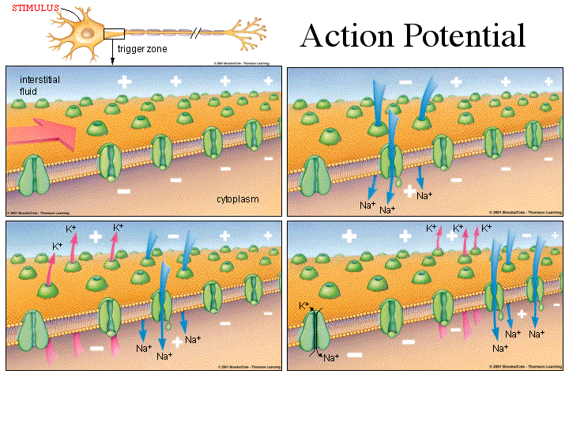

Slide 11
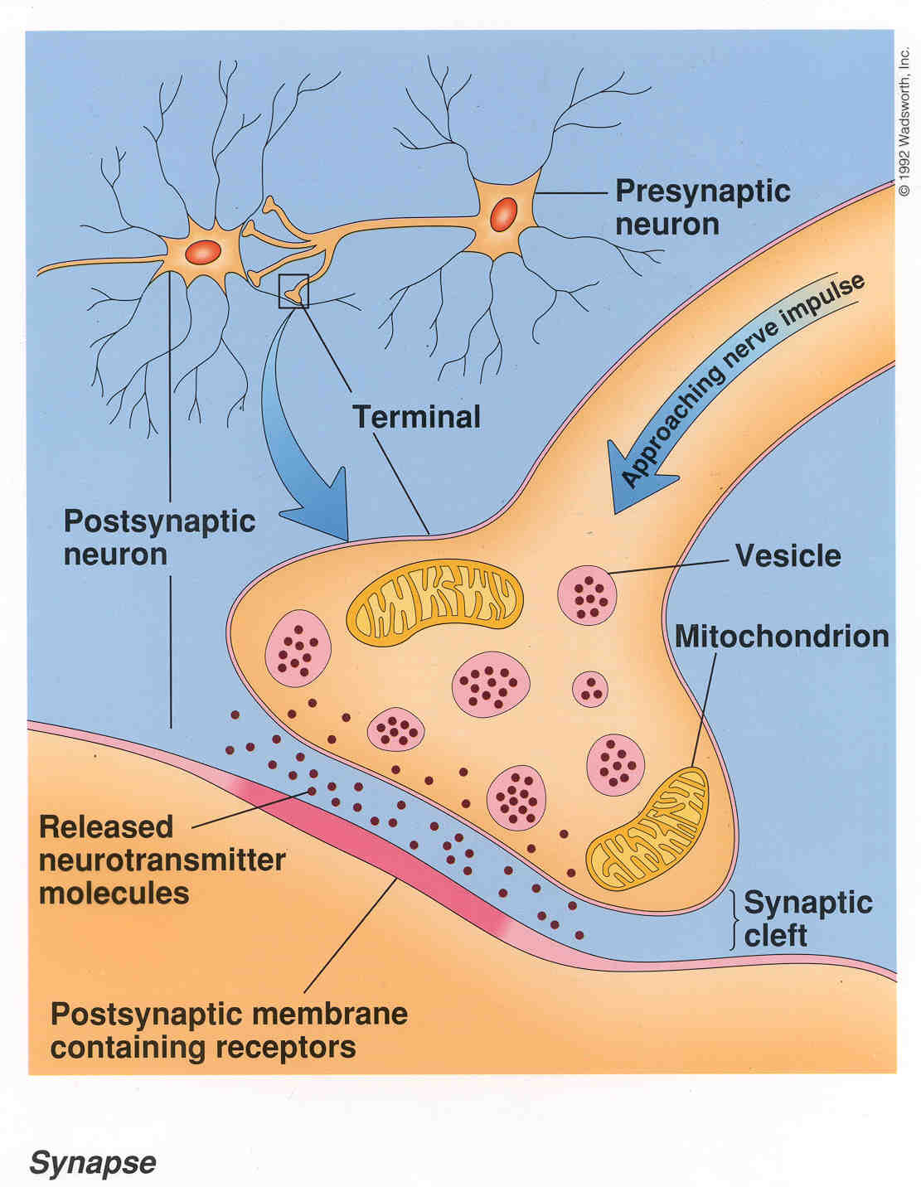
The Synapse

Slide 12
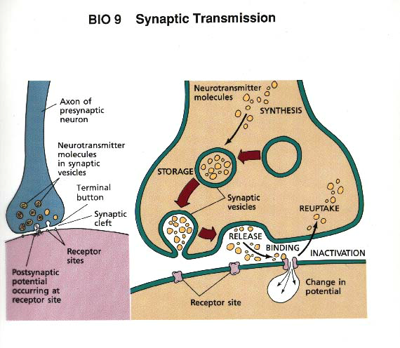

Slide 13
Some Common Neurotransmitters
Acetylcholine
Dopamine
Serotonin
Norepinephrine
GABA
(gamma-amino butyric acid)

Slide 14
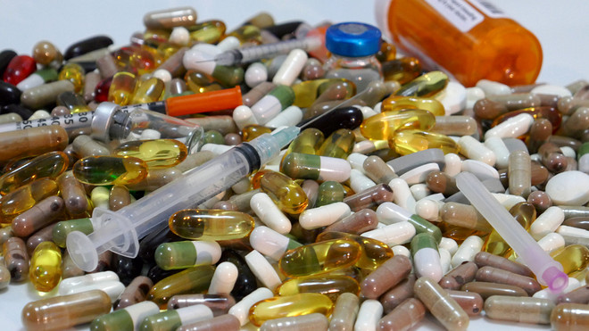
How do Drugs Work?

