Slide 1
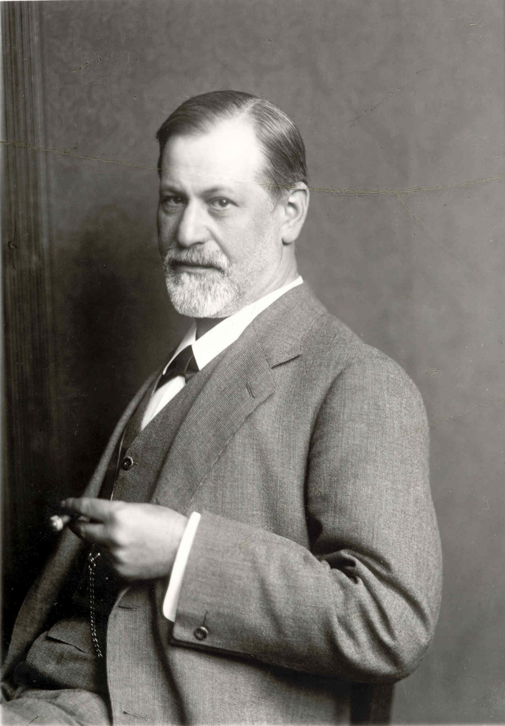
Sigmund Freud & Psychoanalysis
Freud: 1856-1939

Slide 2
Psychosexual Stages of Development
Oral Stage ( Lasts for first 12-18 months)
Anal Stage (1-1.5 years through age 3 or so)
Phallic Stage (about 3 until about 6)
Oedipus Complex
Latency Stage ( 6 until puberty)
Genital Stage (puberty through adulthood)

Slide 3
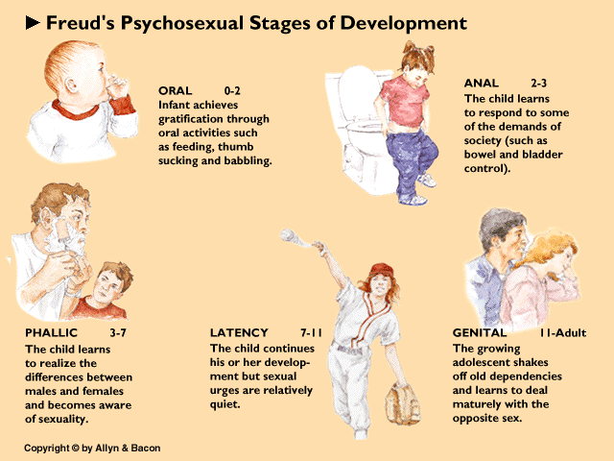
Psychosexual Stages of Development

Slide 4
The Concept of “Fixation”

Slide 5
The Concept of “Fixation”

Slide 6
Psychosexual Stages of Development
Oral Stage ( Lasts for first 12-18 months)
Anal Stage (1-1.5 years through age 3 or so)
Phallic Stage (about 3 until about 6)
Oedipus Complex
Latency Stage ( 6 until puberty)
Genital Stage (puberty through adulthood)

