Slide 1
Conformity

Slide 3
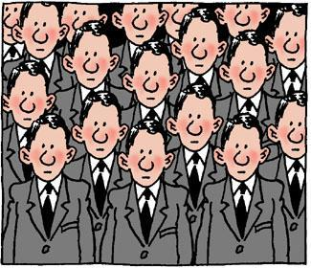
Degrees of Social Influence
Conformity
Compliance
Obedience
Another conformity example

Slide 6
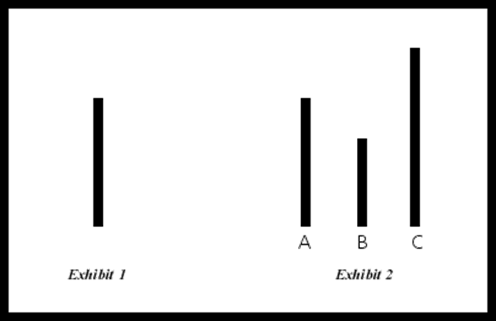

Slide 7
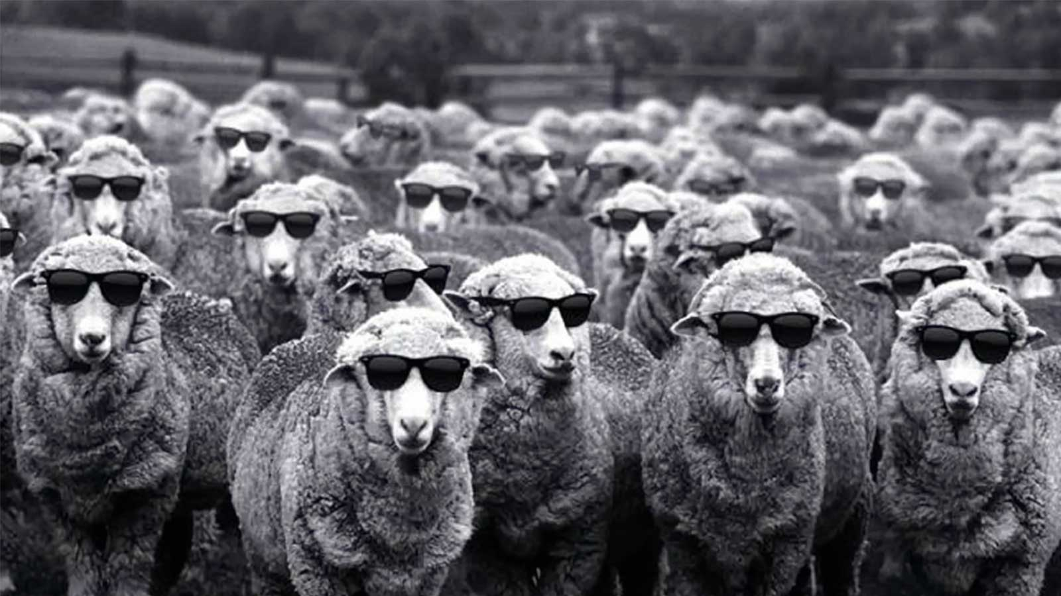
Conformity can be Informational or Normative

Slide 8
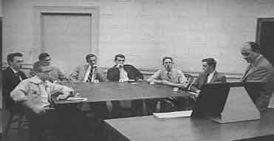
Factors Affecting Conformity
Degree of Social Support
Previous Embarrassment/Deviation
Relative status of group members
Sex and nature of task
Group size (around 4 is optimal)
Group Cohesiveness
Publicity
Ambiguity of Task
Personality
Authoritarianism
Need for Approval
Locus of Control
Self Esteem
Cultural Background
Social Roles

Slide 9
Social Roles

Slide 10
Social Status

Slide 11
RESISTING CONFORMITY
Psychological Reactance
Asserting Uniqueness
Anti-Conformity

