Slide 1
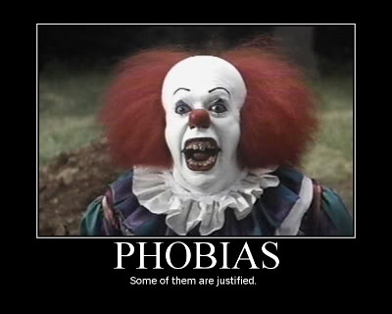
Neuroses
Anxiety Disorders
Generalized Anxiety Disorder (GAD)
Panic Disorder
Attacks of terror (may last seconds or hours)
Often afraid that they are dying or going crazy
Hyperventilation
More common in women
Phobic Disorders
Agoraphobia
Social Phobias
Specific Phobias
Obsessive-Compulsive Disorders
Somatoform Disorders
Dissociative Disorders

Slide 2
Neuroses
Obsessive-Compulsive Disorders
Obsession (thought) leads to compulsion (behavior)
Obsessions center on doubts/uncertainty or fear of doing something prohibited
Common categories: counting, checking, cleaning, avoidance
Somatoform Disorders
Physical symptoms without apparent cause
Somatization Disorder: Pain, heart symptoms, gastrointestinal symptoms
Conversion Disorder: Blindness, deafness, loss of feeling, paralysis.
Often occurs in response to an event
Dissociative Disorders
Dissociative Amnesia
Dissociative Fugue State (Fugue State)
Dissociative Identity Disorder (DID) (Multiple Personality Disorder)

