Slide 1
Types of Memory
Declarative Memory:
- Episodic Memory
- Semantic Memory
Implicit Memory (versus explicit memory)
Procedural Memory
Prospective Remembering

Slide 2
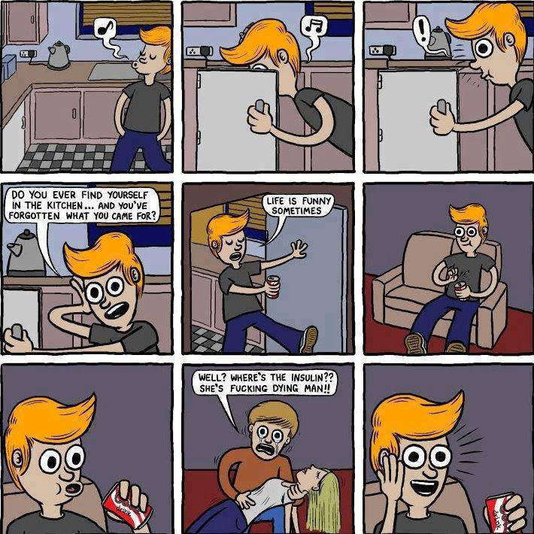
Prospective Remembering

Slide 3
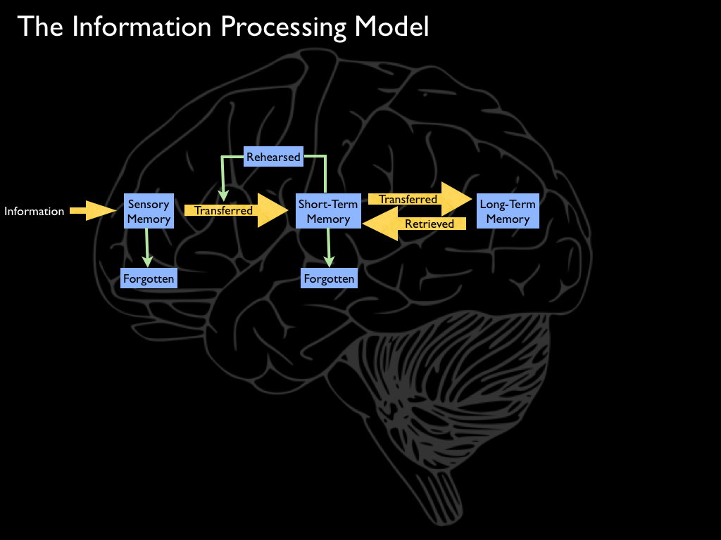
The Information-Processing Model of Memory

Slide 4
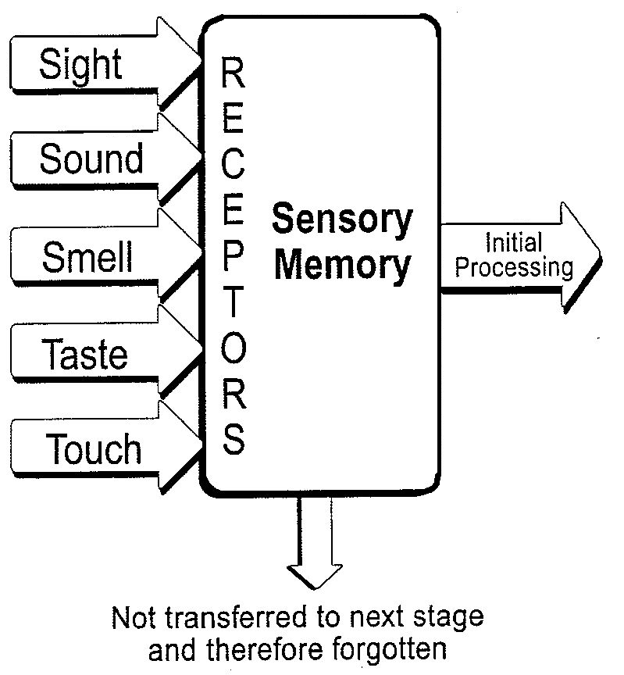
Sensory Memory (Also known as Sensory Register or Sensory Store)

Slide 5
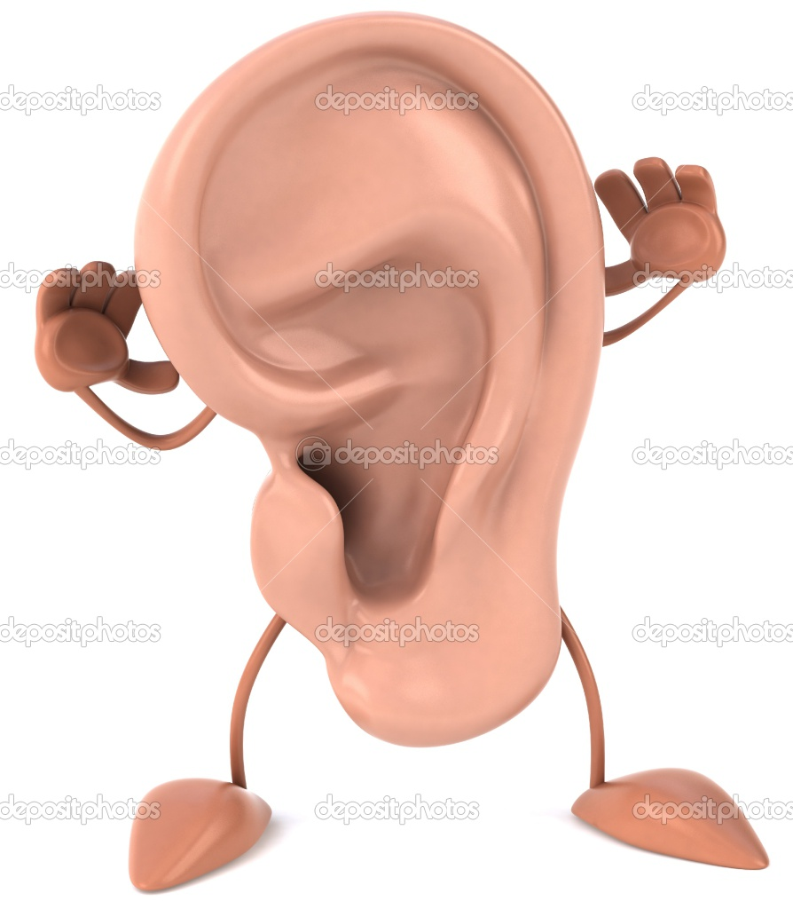
SENSORY MEMORY
Visual Sensory Memory
(the Icon)
Auditory Sensory Memory
(the Echo)
Lasts .25 to .5 seconds; never more than I second
Lasts up to two seconds

Slide 6
Short- vs. Long-Term Memory
Short Term Memory
Long Term Memory
Limited Capacity
Rapid Forgetting
Rehearsal
Maintenance
Elaborative
Unlimited Capacity
Retrieval Problems rather than forgetting
Associative In Nature

Slide 7
The Information-Processing Model of Memory

