Slide 2
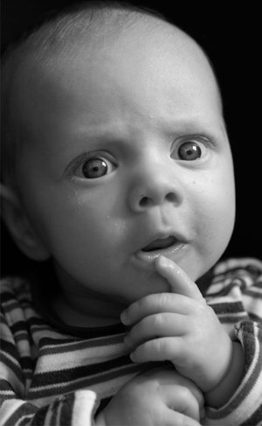
What standards do YOU use to decide if something is “TRUE”?
Can anything EVER be “Proven”?
Stop thinking in terms of absolutes & accept the tentative nature of knowledge
Avoid using the word “Prove”

Slide 3
What standards do YOU use to decide if something is “TRUE”?
Most people do not make a distinction between “Believing” something & “Knowing” something

Slide 4
Principles of Scientific Psychological Thinking
Skepticism (and parsimony!)
Empiricism
Quantitative Thinking
Experimental Thinking
Accept principle of scientific determinism

Slide 5
Benefits of Psychological Thinking
Prevents confusion between observations and inferences
Protects us from intuition & hindsight bias
Become wary of “Bubbapsychology”
Avoid the “Power of the Particular”
Become aware of confirmation bias & illusory correlations

Slide 6
What standards do YOU use to decide if something is “TRUE”?
Can anything EVER be “Proven”?

