Slide 1
Theoretical Perspectives on Aggression
The Frustration-Aggression Hypothesis (Dollard, et. al., 1939)
Freudian Theory
Social Learning
Evolutionary Psychology

Slide 2
Social Learning of Aggression (reinforcement & punishment)

Slide 3
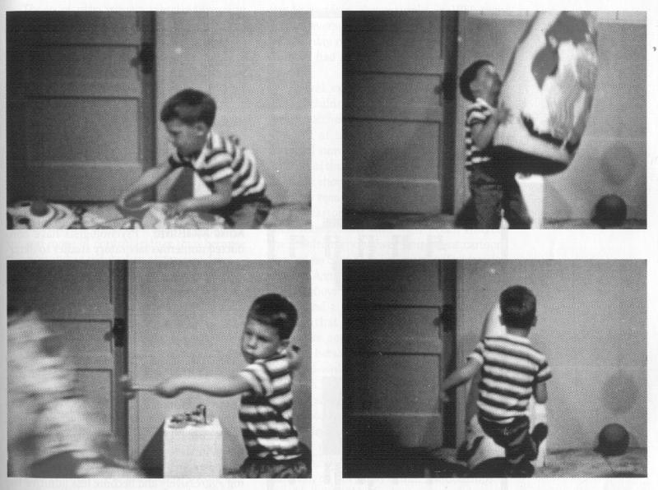
Social Learning of Aggression (Observational Learning (Albert Bandura))

Slide 4
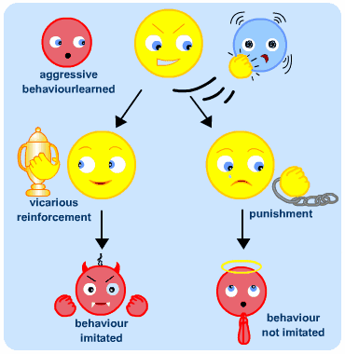
Observational Learning/Modeling

Slide 5
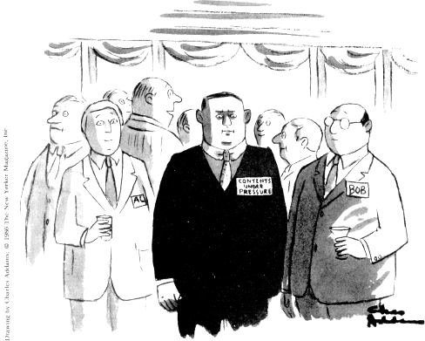
Reducing Aggression: Catharsis or Disinhibition?

Slide 6
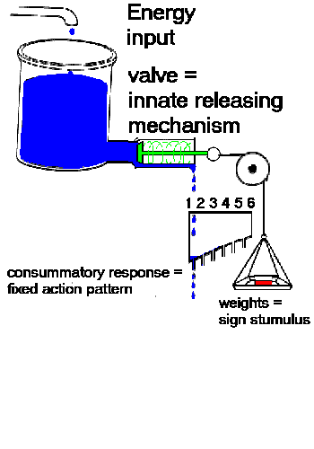
Hydraulic Model of Aggression

Slide 7
Reducing Aggression: Catharsis or Disinhibition?

Slide 8
Example of an Experiment on Catharsis
The Bushman (2002) “Punching Bag” Study

Slide 9
PUNCH!
Deliver
Blasts
of
Noise
&
Measure
Emotional Response
Rumination
Subjects
Made Angry
Control
No
Punch
Distraction
PUNCH!

Slide 10
So – Does Catharsis Work?

Slide 11
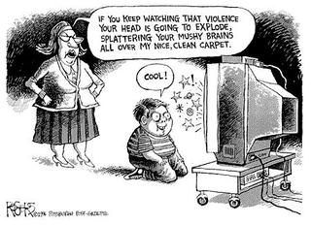
Television & Violence

Slide 12
Mediating Variables in the Television-Aggression Relationship
Personality of Individual
Is the focus on violent behavior or on internal feelings that lead to it?
What Happens to Model?
Is Aggression Presented as Justified?
Are the Results of Violence Shown?
Are Viewers Angry to Begin With?
Adaptation to Violence Occurs Over Time
How do other Viewers Respond to Violence?
Males may be more susceptible than females
Seeing bad guy get it in the end may not work the way we hope it will
Race/Ethnicity may be an important but neglected variable

Slide 13
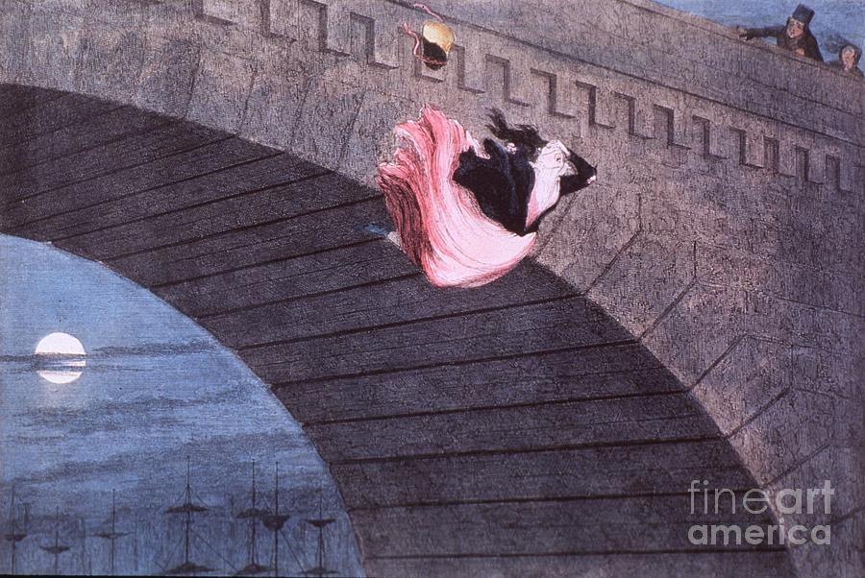
Media & Suicide

Slide 14
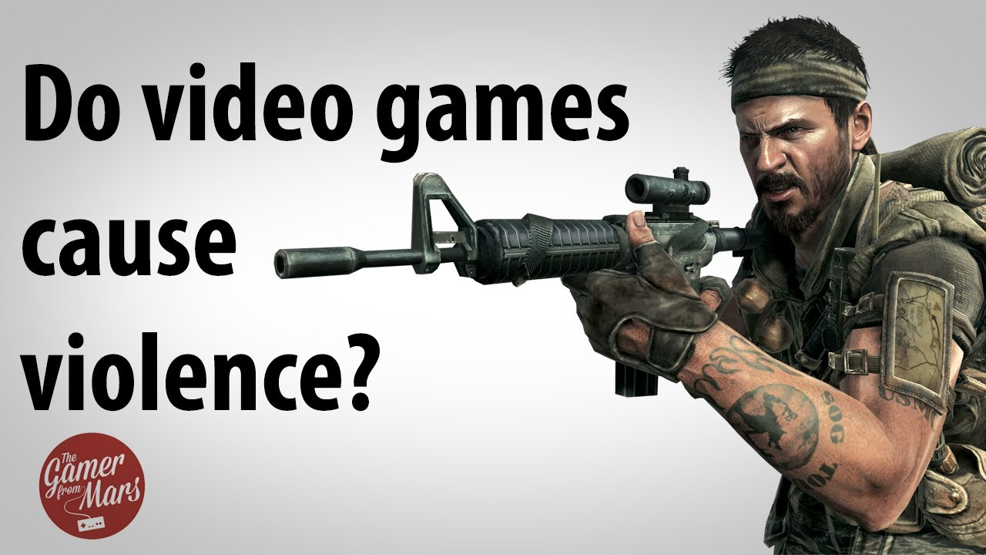

Slide 16
