Slide 1
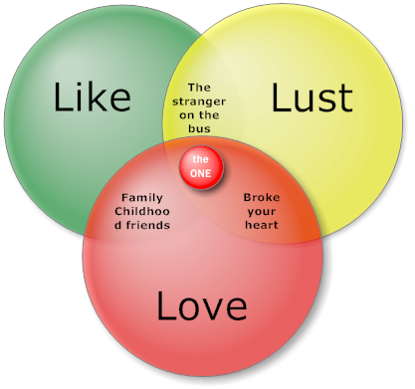
How Is “Liking” Different from “Loving,” and are there Different Types of Love?

Slide 2
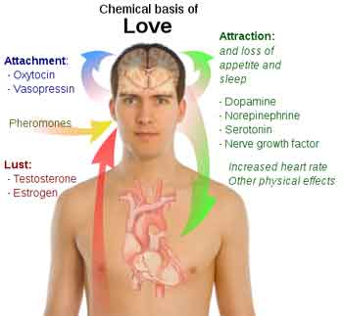
Love has a Chemical Component that Liking Lacks

Slide 3
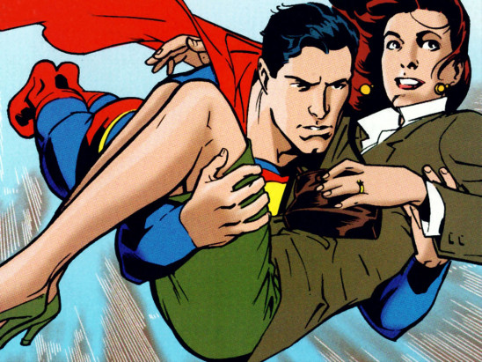
Misattribution of Arousal & Romantic Attraction
Does Adrenalin make the heart grow fonder?

Slide 4
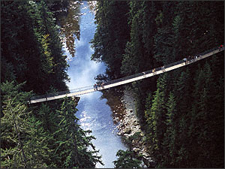
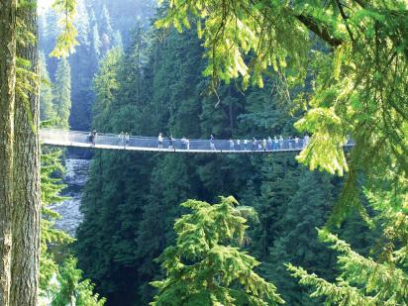
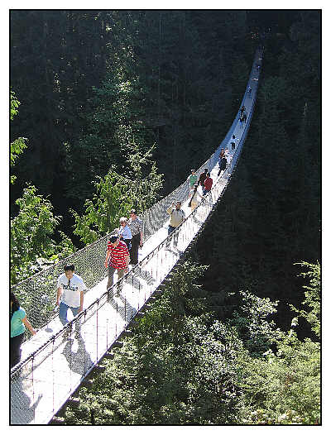
Capilano River Suspension Bridge

Slide 5
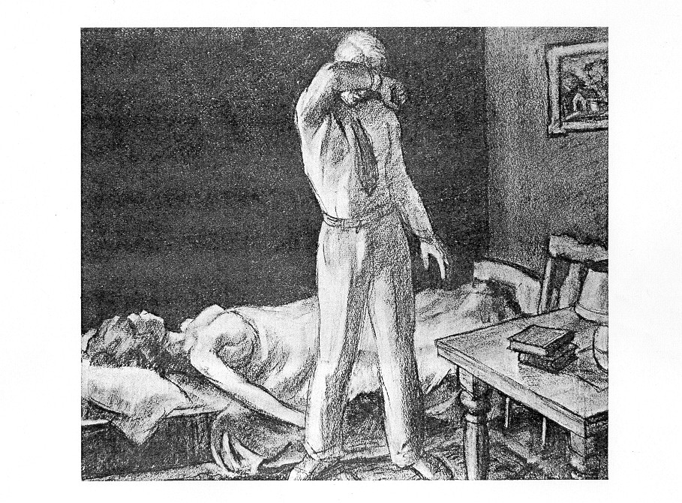

Slide 6
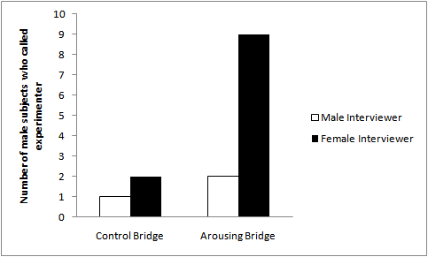

Slide 7
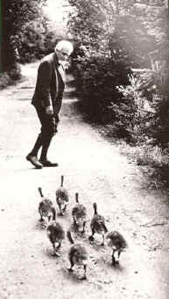
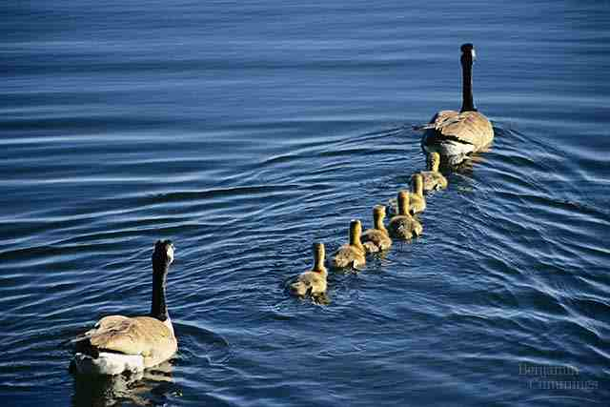
Imprinting

Slide 8
The Measurement of Love
Rubin’s “Liking” vs. “Loving” Scales (1970)
The “Love Attitudes” Scale
(Hendrick & Hendrick, 1986, 1992)
Sternberg’s Triangular Model of Love (1986)
The Passionate Love Scale
(Hatfield & Sprecher, 1986)

Slide 9
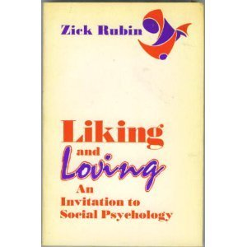
Rubin’s Like & Love Scales

Slide 10
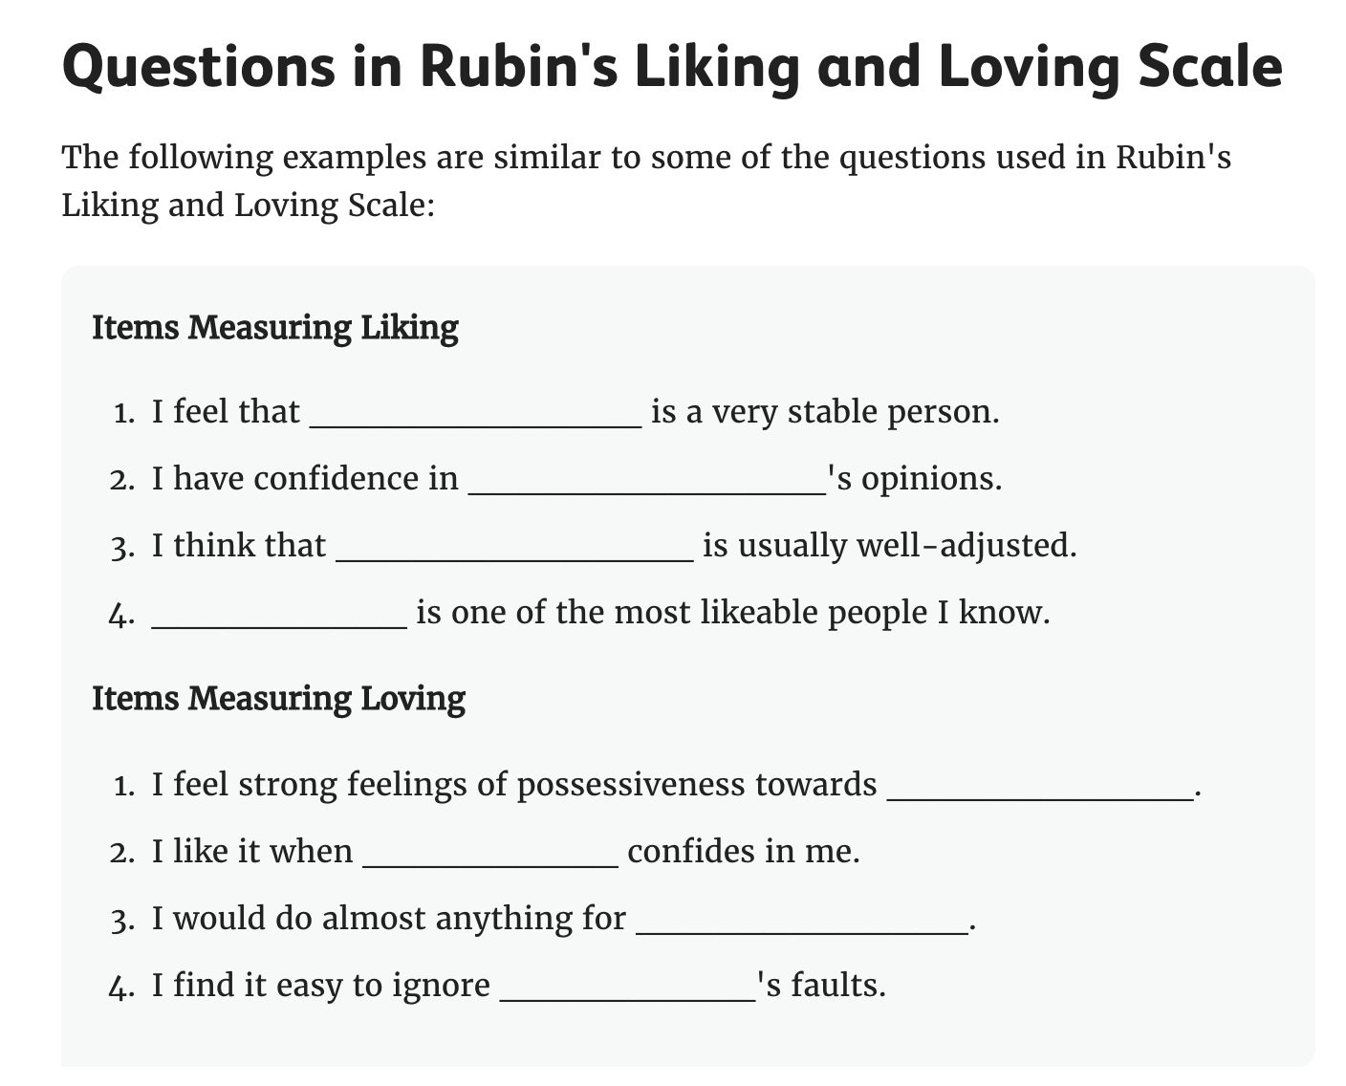

Slide 11
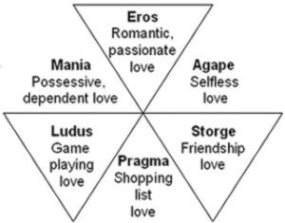
Styles of Love (From the Love Attitudes Scale)

Slide 12
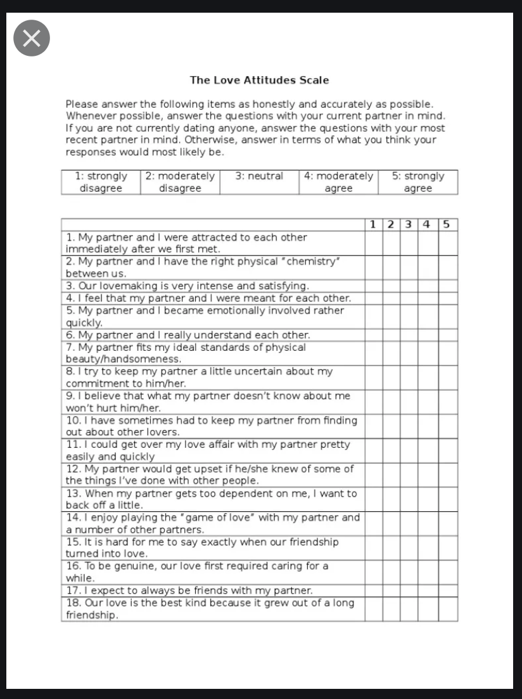
The “Love Attitudes Scale” (Hendrick & Hendrick, 1992)

Slide 13
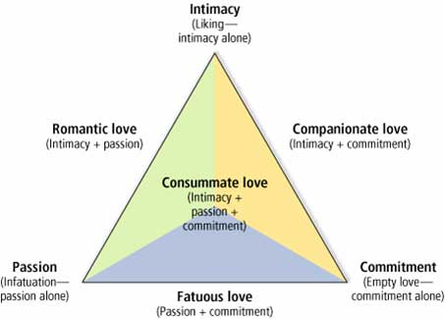
Sternberg’s Triangular Model of Love

Slide 14
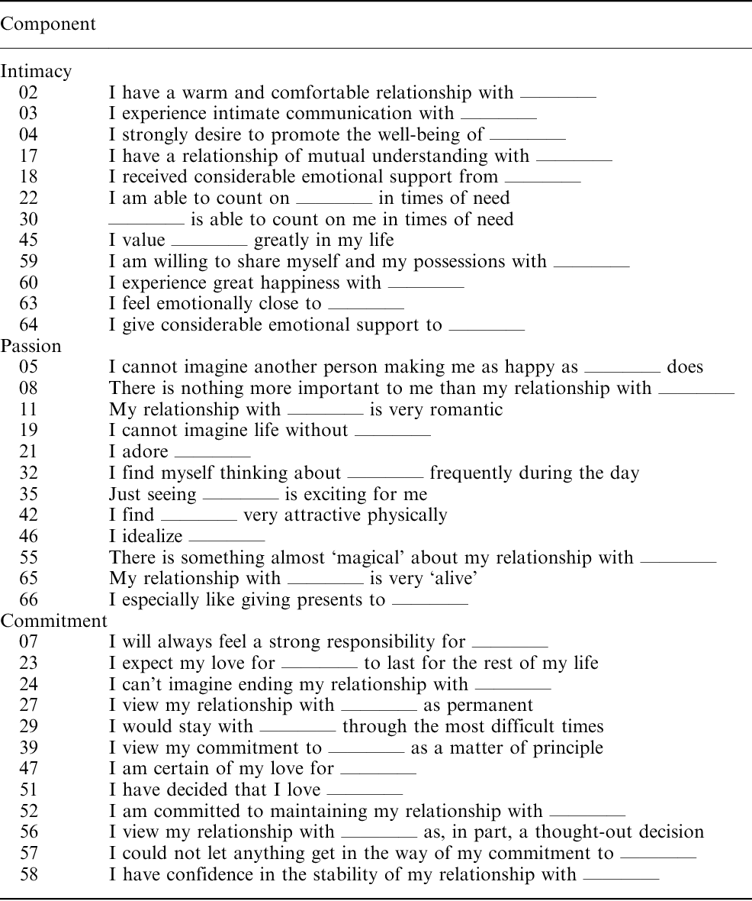
Sternberg’s Triangular Love Scale

Slide 15
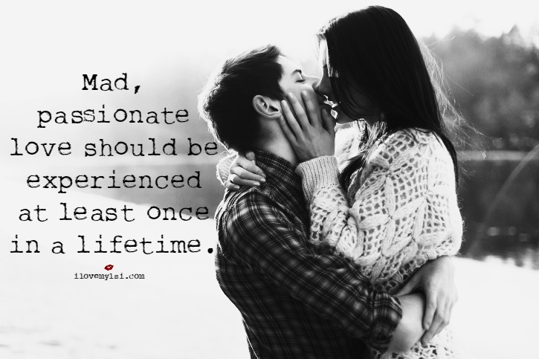
Passionate Love vs. Companionate Love

Slide 16
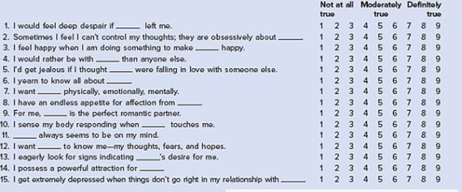
The Passionate Love Scale (Hatfield & Sprecher, 1986)

Slide 17
Passionate Love vs. Companionate Love

Slide 18
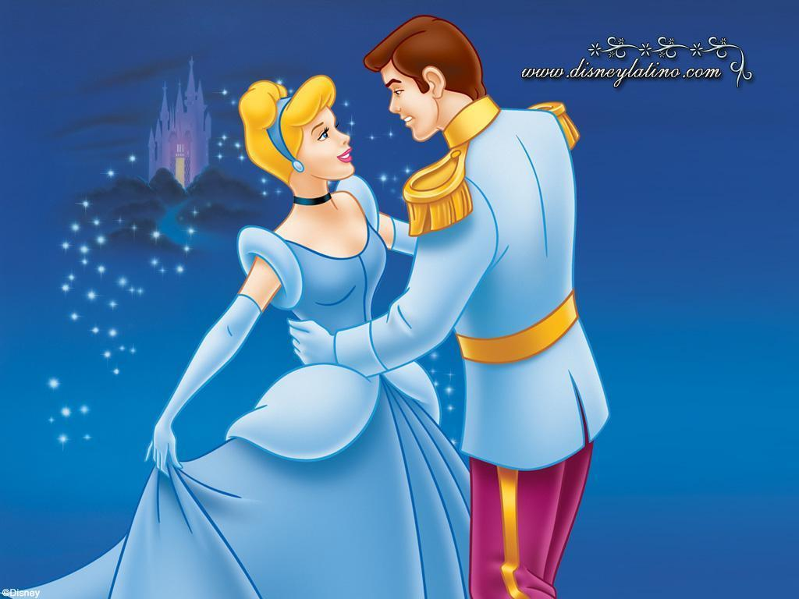
Dating, Mating, & the “Romantic Ideal”

