Slide 1
Leadership

Slide 2
There is a Difference between Leadership “Emergence” and Leadership “Performance”

Slide 3
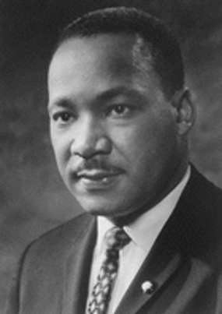
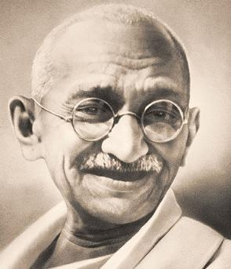
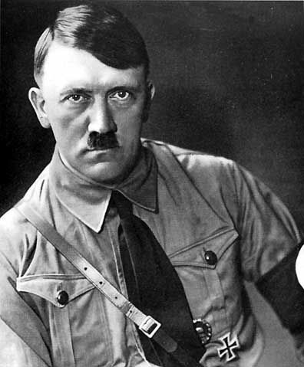
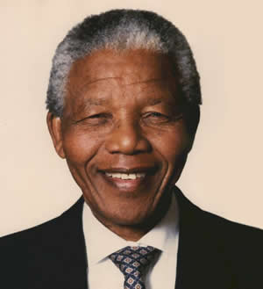
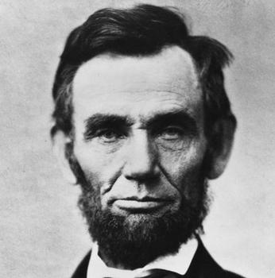
The Trait Approach to Leadership (The “Great person” theory of leadership)
Inspired by the Success of Great Leaders

Slide 4
Charismatic & Transformational Leadership
Inspired by “Transformational” Leaders
Emerge during times of crisis
Charismatic, Inspirational, Visionary; Generates Enthusiasm
Long term-goals; future oriented
Confident; strong sense of being right
Lead by example; confident, optimistic
Articulate clear vision and strategy to get there
They transform the outlook & behavior of others
They get others to transcend self-interest & work for good of group

Slide 5
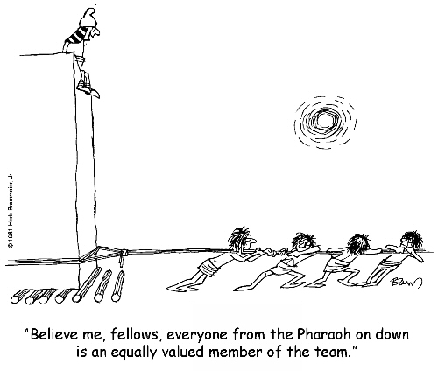
Other Relevant Characteristics of Leadership
Legitimacy (Endorsement)
Can be “appointed” or “emergent”
Style of Leadership
Task-Oriented (Theory X)
Person-Oriented (Theory Y)
Autocratic (induces hostility)
Democratic
Laissez-Faire

Slide 6
Task Versus Person Orientation
Person-Oriented Leaders (Social Leaders, Theory Y Leaders)
act in a warm, supportive manner and show concern for the employees
believe employees are intrinsically motivated
Task-Oriented Leaders (Theory X Leaders)
set goals and give orders
believe employees are lazy and extrinsically motivated

Slide 7
Situational Favorability Fiedler’s Contingency Model
Least-Preferred Coworker Scale
Situation Favorability
high task structure
high position power
good leader-member relations
High LPC leaders best with moderate favorability and Low LPC leaders best with low or high favorability

Slide 8
Relationship Between LPC Scores and Group Success
High LPC Score | Low Performance | High Performance | Low Performance
Low LPC Score | High Performance | Low Performance | High Performance
 | Low | Moderate | High
 | Situation Favorability

