Slide 1
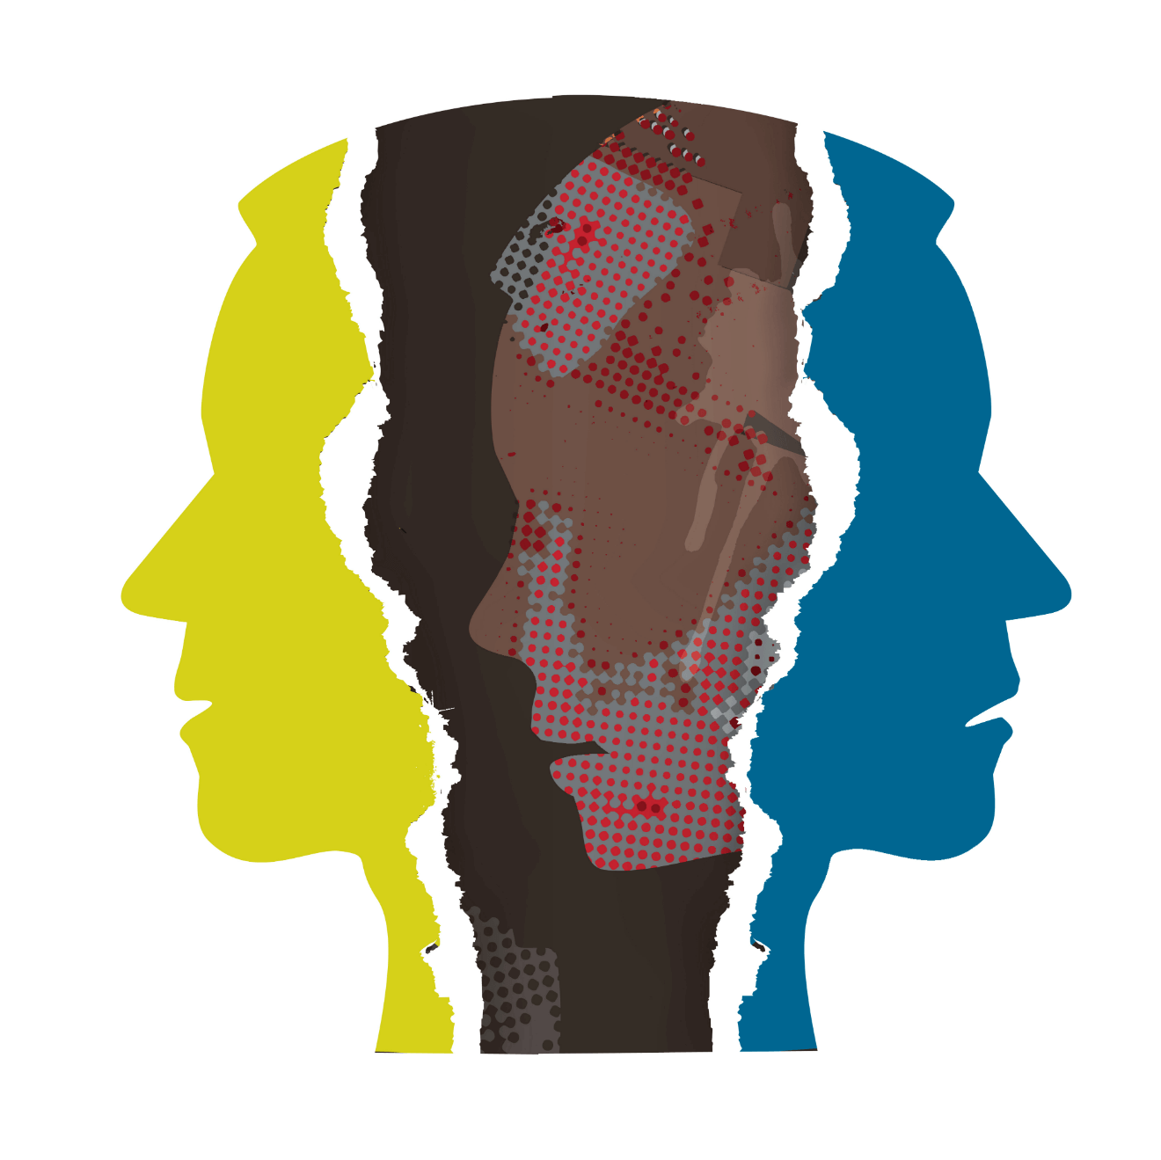
Schizophrenia
Schizophrenia can be “Reactive” (a single episode)
Schizophrenia can be “Process” (chronic & recurrent)

Slide 2
Psychoses (Schizophrenia)
Positive Symptoms of Schizophrenia
Thought & Speech Disorders
Loose associations; word salads; clang associations
Excessively concrete thinking
Hallucinations (Usually auditory)
Delusions
Persecution
Grandeur
Somatic
Control
Reference
Negative Symptoms of Schizophrenia
Flattened, blunted emotions; apathetic
Poverty of speech
Social Withdrawal
Lack of Initiative
Inability to experience pleasure

Slide 3
Diagnosis of Schizophrenia
A person is diagnosed as schizophrenic if
There is a deterioration of daily functioning AND
They show at least One of the positive symptoms of schizophrenia
(hallucinations, thought disorders, delusions)
AND at least two symptoms overall
Catatonia
Catatonic postures; Waxy Flexibility
Alternates with repetitive activity

Slide 4
Causes of Schizophrenia
A Biological predisposition activated by stress
Positive symptoms seem to be the result of too much Dopamine activity
(Can be treated by Chlorpromazine [Thorazine])
Negative symptoms appear to be due to an actual loss of brain tissue
Evidence indicates a genetic link
Neurodevelopmental hypothesis:
Nervous system impairments that develop around the time of birth (not necessarily genetic)
(e.g., People in North born in winter are at greater risk)

