Slide 1
Theoretical Perspectives on Aggression
The Frustration-Aggression Hypothesis (Dollard, et. al., 1939)
Freudian Theory
Social Learning
Evolutionary Psychology

Slide 2
The Frustration-Aggression Hypothesis (Dollard, Doob, et. Al, 1939)
Frustration will always lead to aggression
Frustration is the cause of all aggression

Slide 3
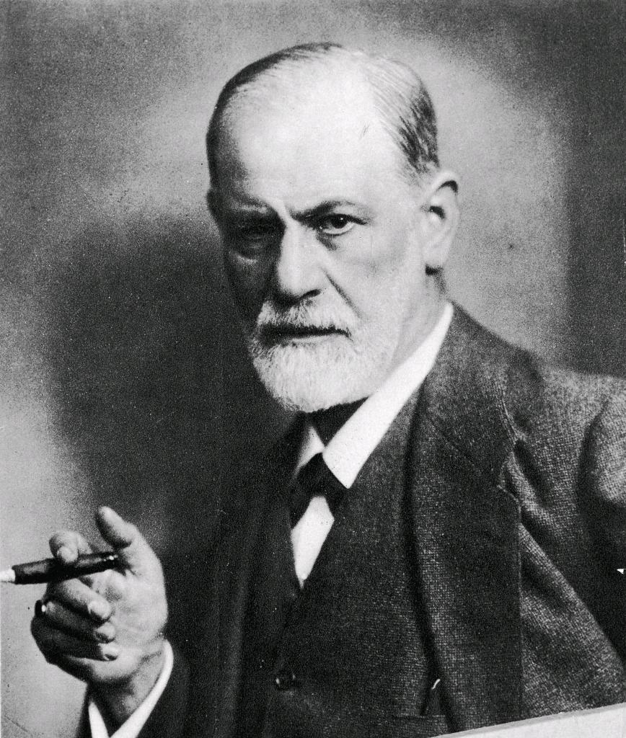
Freudian Theory
EROS: The Sex Instinct
(generates Libido)
THANATOS: The Death Instinct

