Slide 1
Third Force Psychology
A Reaction against determinism of Behaviorism & Psychoanalysis
Human behavior is NOT determined
Humans are free to choose their own existence
A Combination of Humanistic & Existential Psychology
Focus is on helping healthy individuals achieve full potential
Humanistic Psychology: People are innately good; We strive to actualize our inner potential
Existential Psychology: We need to create meaning in our life and “Take charge”

Slide 2
Third Force Psychology
Famous Third-Force Psychologists
Martin Heidegger (Existential)
Rollo May (Humanistic)
Erich Fromm (Existential)
Psychopathology results from cultural forces that prevent us from creating meaning
Abraham Maslow (Humanistic)
Psychopathology results from failure to satisfy needs (especially self-actualization needs)
Carl Rogers (Humanistic)
Psychopathology results from a lack of positive self-regard created by “conditions of worth”

Slide 3
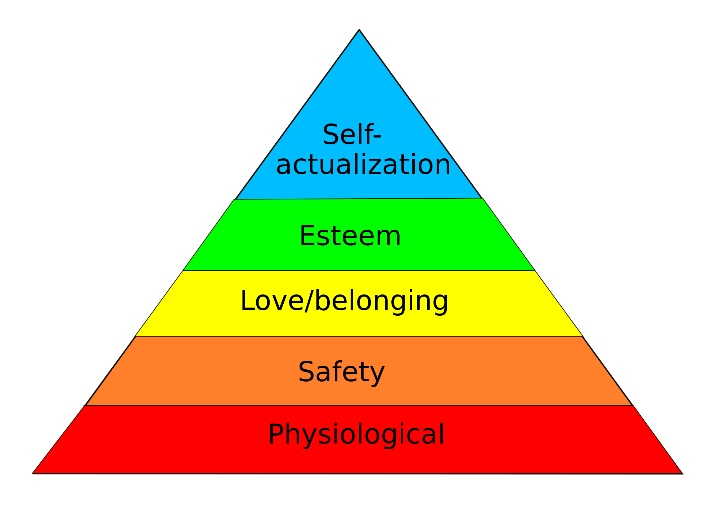
Maslow’s Hierachy of Needs

