Slide 1
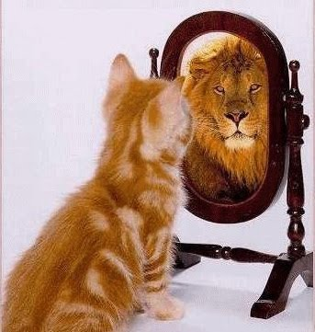
Biases in Social Cognition
Self-Serving Biases
General Self-Serving Bias
Spotlight Effect
Self-Righteous Bias
False Consensus
False Uniqueness
Unrealistic Optimism

Slide 2
Biases in Social Cognition: The Ultimate Attribution Error
Positive Illusions about the In-Group
Negative Illusions about the Out-Group
Examples: Out-group Homogeneity Effect, Ultimate Attribution Error

Slide 3
General Biases in Processing Self & Social Information
Fundamental Attribution Error
Actor-Observer Effect
Illusory Correlations/Confirmation Bias
Primacy Effects
Power of the Particular
Belief Perseverance
Impact Bias (related to “affective forecasting”)
The Overconfidence Phenomenon
Availability Heuristic
Representativeness Heuristic

Slide 4
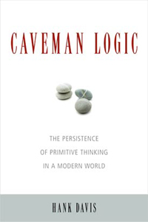
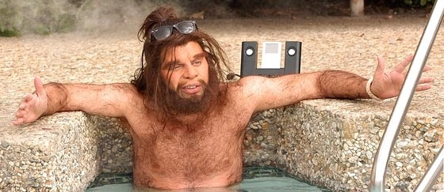
Why do humans have social cognition biases?
EVOLUTION?

Slide 5
How did we have to think to be successful?
Remembering details about individuals we knew personally
Detecting cheaters & altruists
Liars who don’t know they are lying cannot undermine themselves
Optimism = persistence, coping with stress, etc
Distinguishing in-group members from out-group members
Loyalty mattered! Ostracism was fatal

