Slide 1
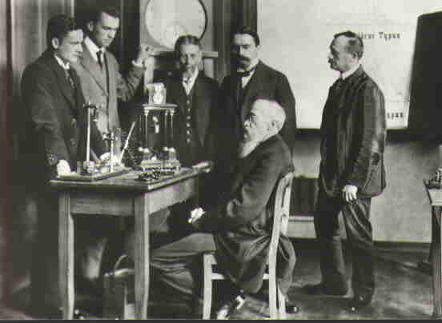
Research Settings
Laboratory Studies
Advantages
Control over situation
Random assignment is possible
Control over independent variable
Sensitive measurement of dependent variable
Disadvantages
Demand Characteristics!
Limitations on possible manipulations
Questions of reality and generalization

Slide 2
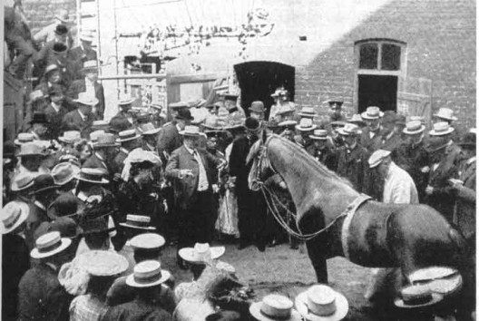
Field Studies
Advantages
Minimizes suspicion
Different types of subjects available
Can study more powerful variables
Disadvantages
Lack of control over situation
Random assignment is difficult
May be hard to get pure dependent measures
Often more awkward and costly

