Slide 1
Psychoanalysis
Goal: Seek insight into the unconscious, achieve catharsis & release from tension
Tools of Psychoanalysis:
Hypnosis
Free Association
Analysis of Dreams

Slide 2
Other Influential People in Psychoanalysis
Carl Jung (1875-1961)
Alfred Adler (1870-1937)
Karen Horney (1885-1952)
Harry Stack Sullivan (1892-1949)
Otto Rank (1884-1945)

Slide 3
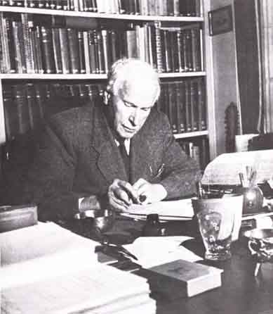
Carl Jung (1875-1961)
Psychic energy still an outcome of conflict between opposing forces in personality, but it is not all about sex.
There is a personal AND collective unconscious
Instincts & Archetypes
The Persona
The Shadow
The Animus & Anima
His “Theory of Psychological Types” is very influential in psychology today; the basis of the Myers-Briggs Type Indicator (MBTI)
Developed advanced techniques for the interpretation of dreams.

Slide 4
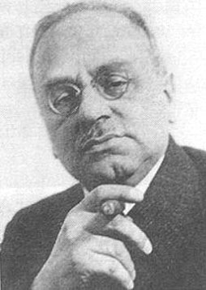
Alfred Adler (1870-1937)
He called his system “Individual Psychology”
An Individual’s Goals direct his or her behavior
Striving for perfection & completion
Overcoming feelings of inferiority & striving for superiority
Organ Inferiority
Masculine Protest
Inferiority Complex
Social Interest
Style of Life
Early Childhood Experiences are Critical for Development
Parenting Style (pampering vs. neglect) determine style of life
Birth Order is a critical variable
Goals of Psychotherapy: To promote a socially interested style of life & overcome feelings of inferiority
Uses standard psychoanalytic techniques, especially dream interpretation

