Slide 1
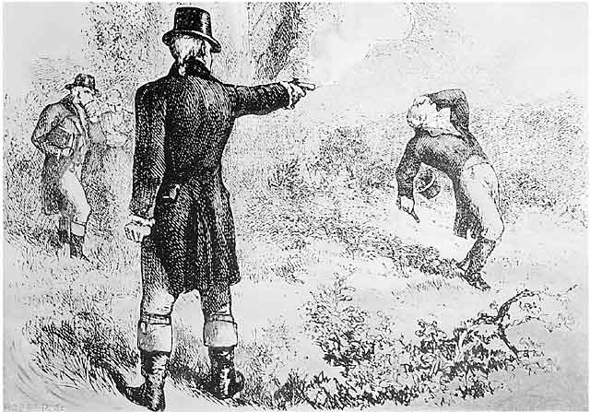
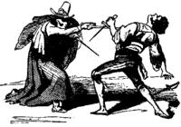
Cultures of Honor

Slide 2
Characteristics of Cultures of Honor
Law enforcement weak or absent
Resources easily stolen by others
Uneven distribution of resources
If culture has stable, strong social organization, anti-social violence will be constrained, but “honor” disputes will be encouraged.

Slide 3
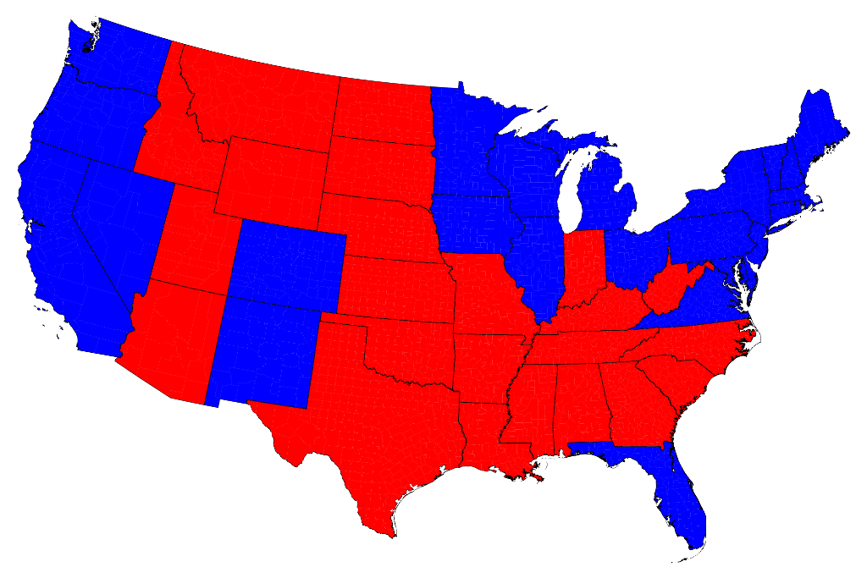
Cultures of Honor in the USA

Slide 4
Selected Research Findings:
Small towns in the South have triple the homicide rates of small towns in the North
Difference in homicide rates due entirely to homicides following argument or insult
Students in Culture of Honor States are more likely to have brought a weapon to school.
There are significantly more school shootings in Culture of Honor states.(twice as many per capita)
Residents of Culture of Honor states desire more extreme, violent responses to terrorist acts.

Slide 5
Selected Research Findings:
Southerners are more accepting of three types of violence:
Self-defense
Corporal punishment of children
Responding to insults
e.g., study of cover letters with job application revealing prison time
People in the West & South watch more violent TV programs
People in the West & South have higher subscription rates to magazines featuring weapons, combat, & physical strength
Southern White males and inner-city Black males respond to insults with more stress, anger, higher levels of arousal, & elevated levels of testosterone
e.g, University of Michigan laboratory study

Slide 6
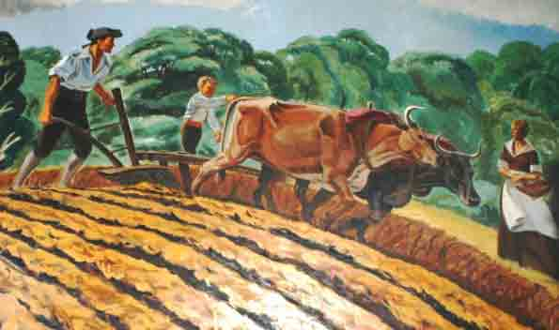
Origins of Regional Differences?
North originally settled by
farmers with Puritan, Quaker,
& Dutch backgrounds

Slide 7
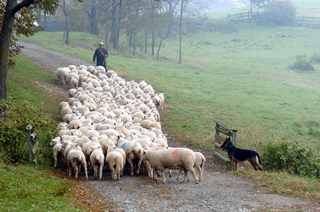
Origins of Regional Differences?
South originally settled by Scotch/Irish settlers with long herding tradition.

Slide 8
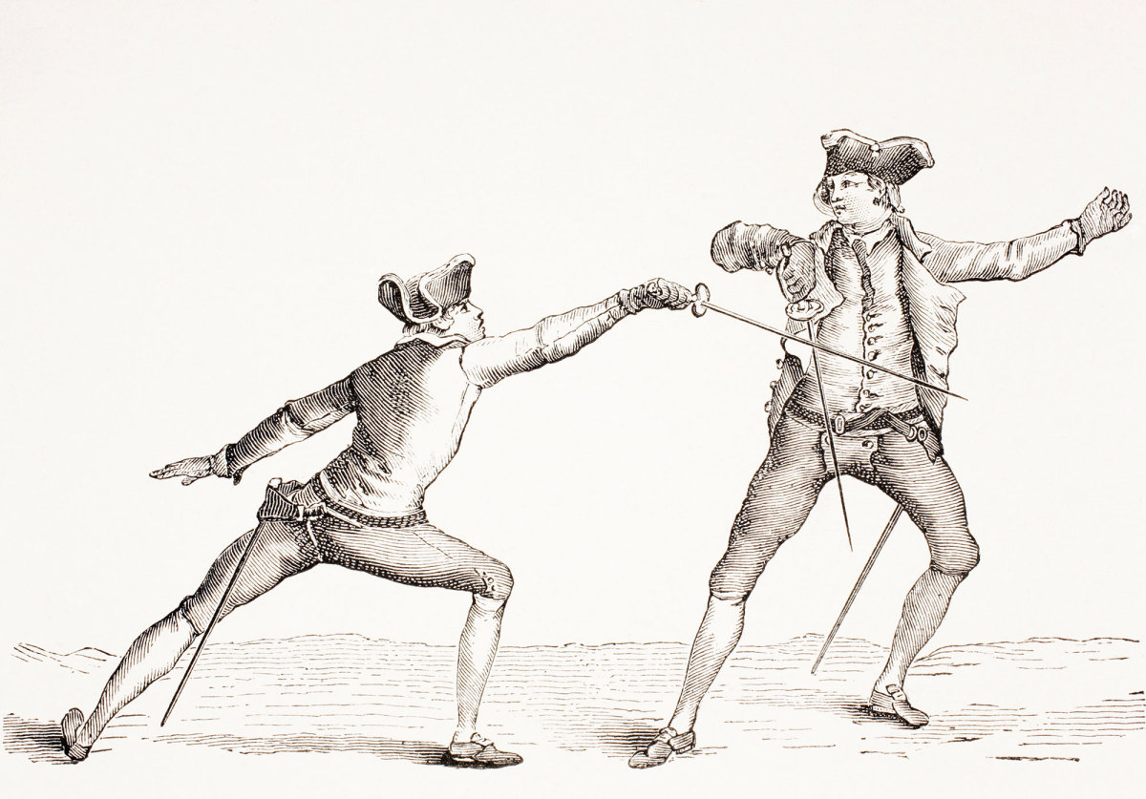
Origins of Regional Differences?
South originally settled by land-owning noble gentry with a long-standing code of manly honor.

