Slide 1
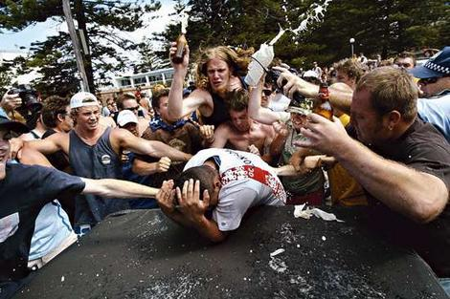
Group Effects on the Individual
Social Facilitation
Social Loafing
Social Compensation
Deindividuation

Slide 2
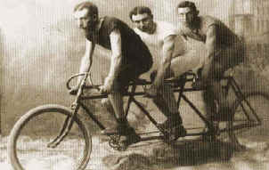
Theoretical Explanations for Social Facilitation
Drive Theory (Zajonc)
Evaluation Apprehension
Distraction-Conflict Model
Social Comparison

Slide 3
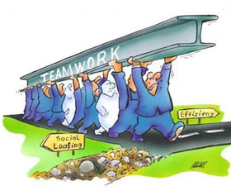
Social Loafing
Decreases when individuals think that their efforts can be monitored
Decreases when task is challenging, appealing, or involving
Decreases with friends and cohesive teams
Loafers are not always aware that they are loafing

Slide 4
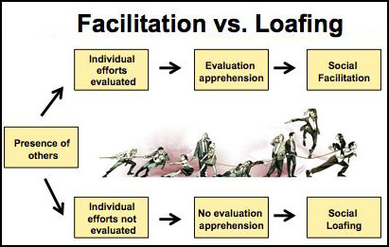

Slide 5
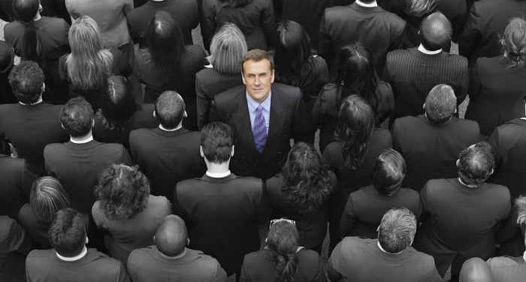
deindividuation

