Slide 1
Individual vs. Group Decision Making

Slide 2
Obstacles to Effective Group Decision Making
Group Polarization/Groupshift
Groupthink
Escalation of Commitment to Bad Decisions
Distraction from task resulting from group interaction
e.g., the “Common Knowledge Effect”

Slide 4
Symptoms of Groupthink
Illusion of Invulnerability
Shared Stereotypes
Illusion of Morality
Extreme Rationalization
Illusion of Unanimity
Strong Conformity Pressures
Contradictory information is ignored/minimized
Self-Censorship
The Presence of a “Mind-Guard”
A Leader Who Promotes a Favorite Decision

Slide 5
How to Avoid Groupthink
Leaders should withhold personal opinions
Divide large group into smaller groups
Appoint a designated “Devil’s Advocate”

Slide 6
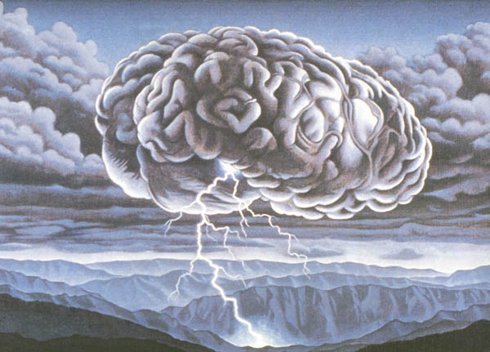
Techniques for Improving Group Decision Making & Problem Solving
Brainstorming
Nominal Group Technique (NGT)
The Delphi Technique

