Slide 1
The Problem of “Selective Attention”
Selective attention can lead to “Change Blindness”
- The failure to detect changes in parts of a scene

Slide 2
Change Blindness
The Door Study
Monkey Business
Basketball
At Harvard
Moonwalking

Slide 3
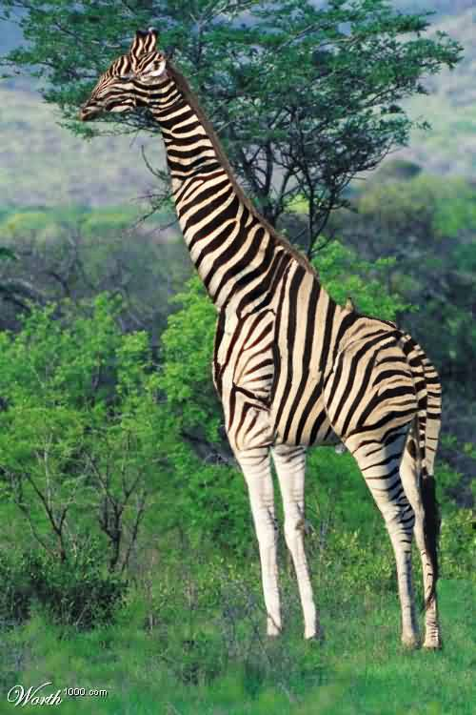
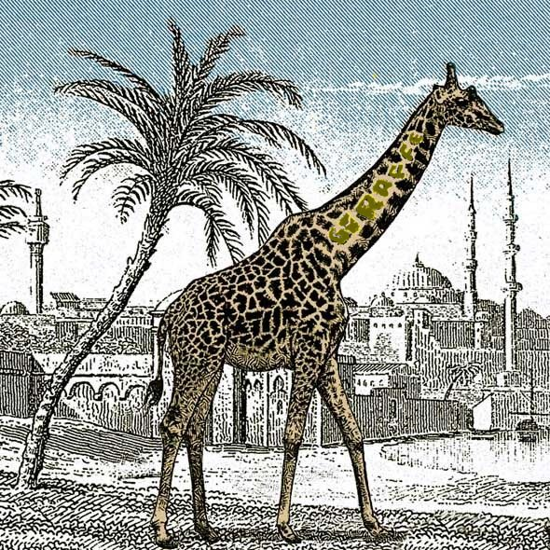

Slide 4
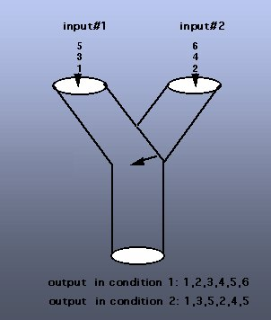
Filter Models of Attention (Broadbent, 1954)

Slide 5
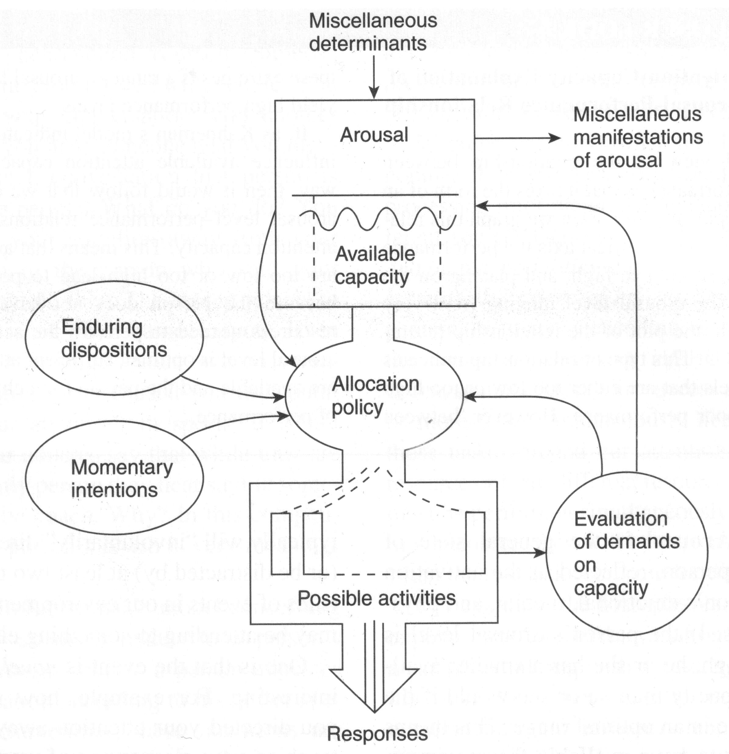
Capacity Models of Attention (Kahneman, 1973)

Slide 6
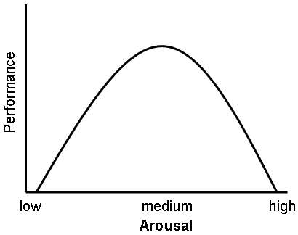
Performance-Arousal Curve

Slide 7
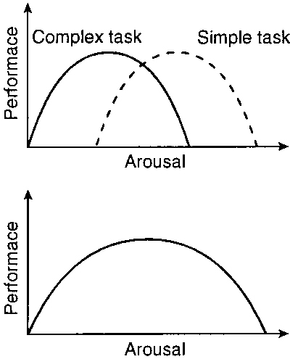
Performance-Arousal Curve

Slide 8
Performing Under Stress: Dealing with an Active Shooter Situation

Slide 9
Capacity Models of Attention (Kahneman, 1973)

Slide 10
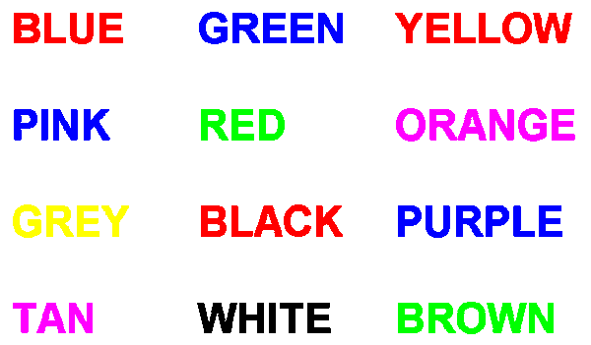
The Stroop Effect

