Slide 1
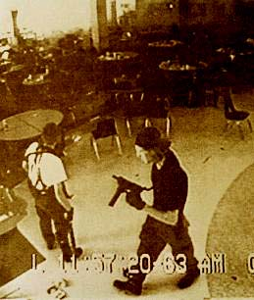
Types of Aggression
Hostile Aggression
Instrumental Aggression
Antisocial Aggression
Prosocial Aggression
Sanctioned Aggression

Slide 2
Some Situational Determinants of Aggression
Hot Temperatures
Noise
Alcohol
The presence of aggression-eliciting cues
Excitation Transfer/Misattribution of Arousal
The personality of the individual and how it interacts with situational demands

Slide 3
Theoretical Perspectives on Aggression
The Frustration-Aggression Hypothesis (Dollard, et. al., 1939)
Freudian Theory
Social Learning
Evolutionary Psychology

