Slide 1
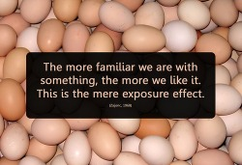
The Effects of Proximity/Familiarity/Mere Exposure

Slide 2
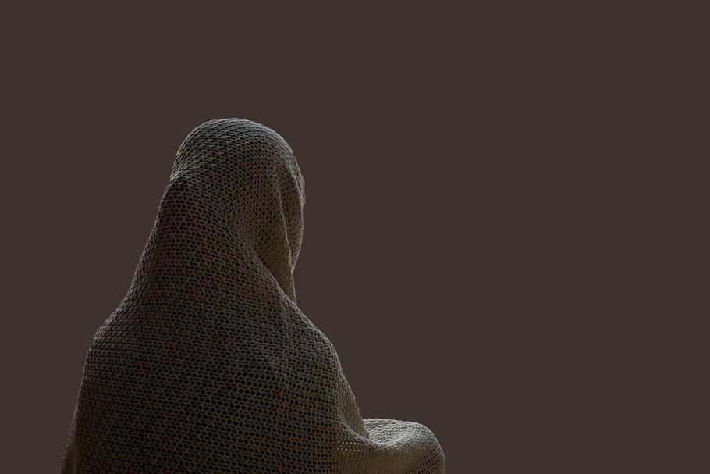
Greater familiarity with almost anything can lead to liking

Slide 3
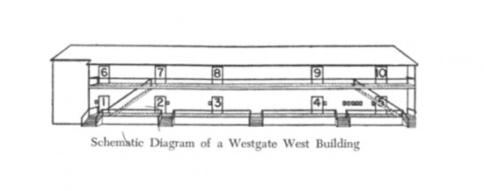
Westgate West

Slide 4
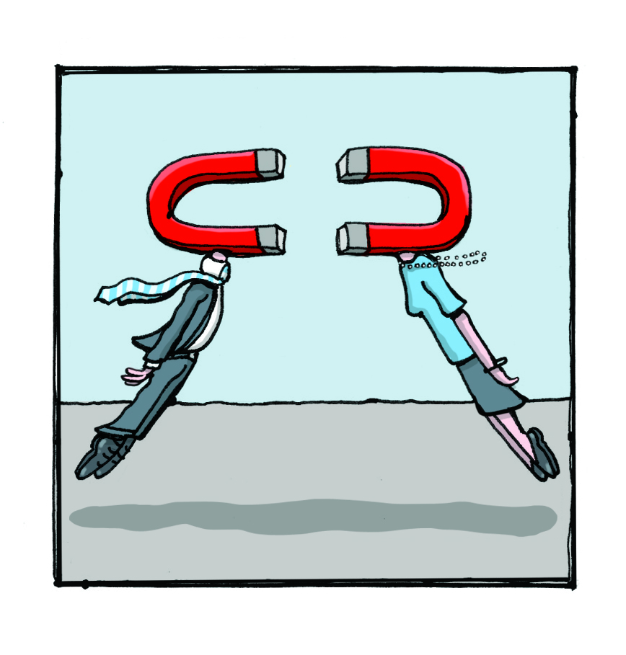
Similarity or Complementarity?

Slide 5
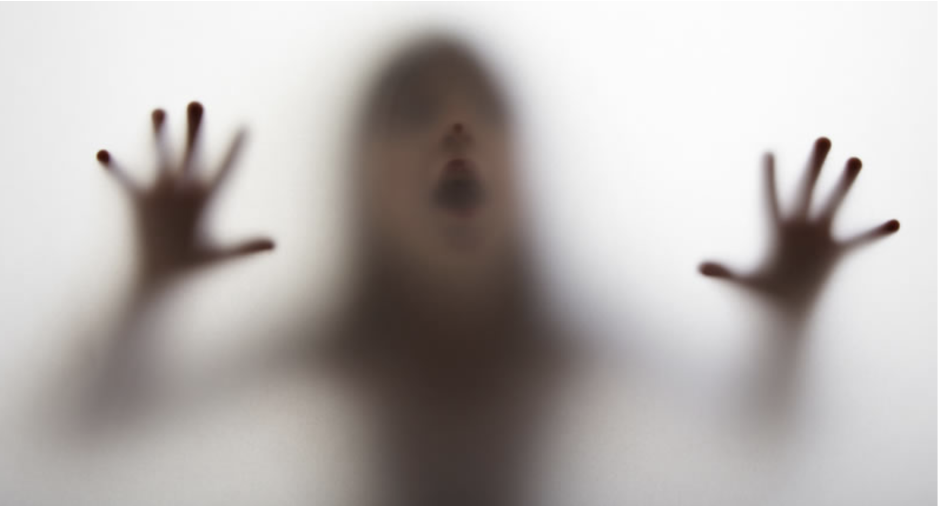
The Phantom Other – A Laboratory Technique for Studying Interpersonal Attraction

Slide 6
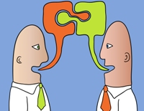
Reciprocity of Self-Disclosure

