Slide 1
Psychotherapy

Slide 2
Types of Psychotherapy
Insight Therapies
Psychoanalysis
Person-Centered Therapy (Humanistic)
Existential Therapy
Gestalt Therapy
Behavior Therapies
Systematic Desensitization
Aversion Therapy
Implosive Therapy/Flooding
Behavior Modification
Cognitive-Behavior Therapies
Rational-Emotive Therapy (RET)
Beck’s Cognitive Therapy for Depression
Cognitive-Behavior Therapy

Slide 3
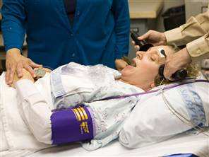
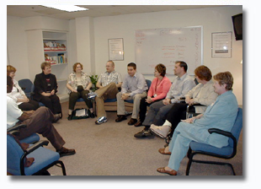
Types of Psychotherapy
Somatic/Biological Therapy
Psychosurgery
Electroconvulsive Therapy
Psychopharmacology
Group Therapy

Slide 4
Does Psychotherapy Work?

Slide 5
Does Psychotherapy Work?
Very Controversial!
Why is it such a difficult question?
Hard to do controlled studies
Individual reports more positive than statistical analysis
Effects in Individual studies are small, but -
Meta-analysis – avg. person in therapy shows more improvement than 80% without therapy.

Slide 6
Professionals Involved in Therapy
Psychiatrists
Clinical Psychologists
Counseling Psychologists
Licensed Clinical Social Workers
Pastoral Counseling
Psychoanalysts & assorted therapists

