Slide 2
Galen’s (130-200 A.D.) Theory of the Four Temperaments
Blood – Cheerful, sanguine, warm-hearted, volatile
Black Bile – Sad, Melancholic
Yellow Bile – Fiery, Quick-Tempered, Person of Action
Phlegm – Slow Moving, Cautious, Phlegmatic

Slide 3
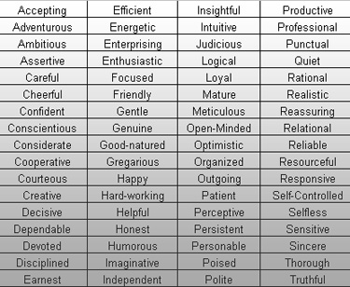
Personality Traits

Slide 4
When are Traits Good Predictors of Behavior?
When they are specific and limited
When an individual is extreme on the trait
Traits predict general behavior over time better than single instances
More specific situations help make traits better predictors
The influence of any personality trait can be overpowered by strong situations

Slide 5
The Metatrait Hypothesis
Personalities of different individuals contain different
clusters of traits, so that traits that are important for
you (self-schematic traits) are more useful than traits
that are not relevant to you (aschematic traits)

Slide 6
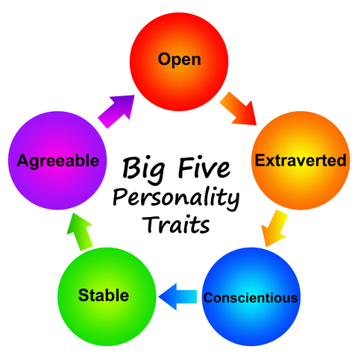
The “Big Five” Personality Traits
Extraversion
Agreeableness
Conscientiousness (Will to Achieve)
Neuroticism (Emotional Stability)
Openness to Experience

