Slide 1
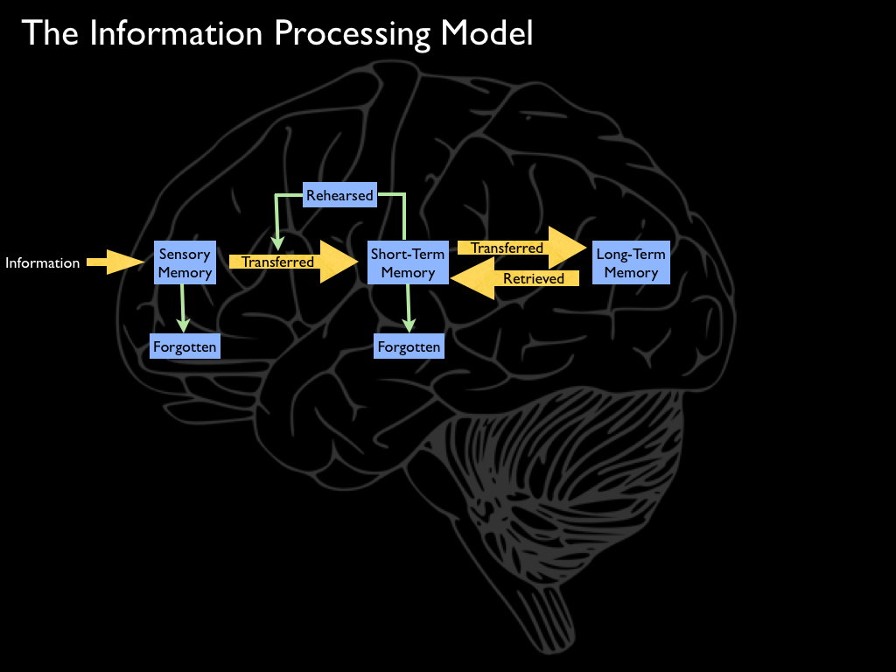
The Information-Processing Model of Memory

Slide 2
Evidence for the Information- Processing Model of Memory
Physiological Evidence
Typical Confusion Errors
Serial Position Effect
Retrograde Amnesia

Slide 3
Levels (Depths) of Processing Theory: A Popular Alternative to the Information-Processing Model
There is no separate STM & LTM
The depth at which you process an incoming stimulus
Determines how well it is remembered
Deeper processing leads to better memory

Slide 4
Levels of Processing: An Example
A memory experiment where subjects process information
in one of three ways:
Physical Appearance: “Is the word printed in capital letters?
Acoustic Processing: “Does the word rhyme with ‘pain’?”
Semantic Processing: “Does the word fit in the following sentence?:
Bill ate the ________ for lunch yesterday.”

Slide 5
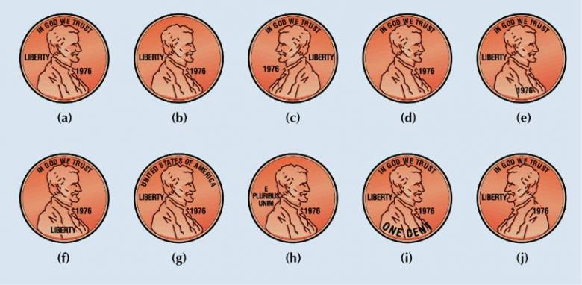
Depths of Processing

