Slide 1
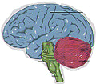

The Mind-Body Problem
(aka, “Mind-Brain” Problem)

Slide 2
Monism
Materialism: Everything is Physical
Idealism: Everything is Mental

Slide 3
Dualism
Interactionism: Mind & Body Influence Each Other
Epiphenomenalism: Mental Events are By-Products of Physical Experience
Psychophysical Parallelism: Outside Event causes Mental & Physical Responses, but they are Independent of Each Other
Double Aspectism: Person cannot be divided; Mind & Body do not interact but they cannot be separated
Preestablished Harmony: Mind & Body are different, but are coordinated and synchronized by some external agent (God?)
Occasionalism: Intervening Agent (God) changes one realm following changes in the other

Slide 4
Dominant Views of Mind-Body Problem in Psychology
Experimental Psychology
  Epiphenomenalism
  Materialistic Monism
Humanistic-Existential Psychology
  Interactionism

Slide 5
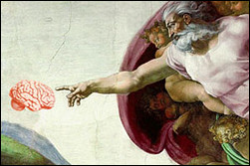
The Architecture of the Human Mind

Slide 6
Perspectives on the “Mind”
*The mind is what the brain does.
*The mind is not one thing, but rather a
collection of things.
*The mind has been shaped by the
process of natural selection, just as
other organs have.
*“Consciousness” is a by-product of brain
activity, and it is not essential to most
functions of the mind.

Slide 7


