Slide 1
Sub-Fields of Psychology
EXPERIMENTAL PSYCHOLOGY:
*Learning/Motivation/Emotion/Sensation/Perception
*Cognitive Psychology
*Neuroscience/Biological Psychology
*Comparative Psychology
*Developmental/Life-Span Psychology
*Social/Personality Psychology
CLINICAL, COUNSELING, AND HEALTH PSYCHOLOGY
INDUSTRIAL/ORGANIZATIONAL PSYCHOLOGY:
*Personnel Psychology & Psychometrics
*Organizational Behavior
*Consumer Psychology
*Engineering Psychology & Human Factors
EDUCATIONAL PSYCHOLOGY:
(Research, Training (corporate), School Psychology)

Slide 2
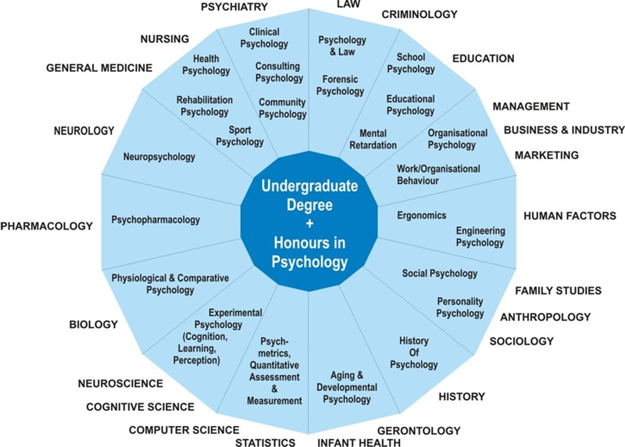
Careers in Psychology

Slide 3
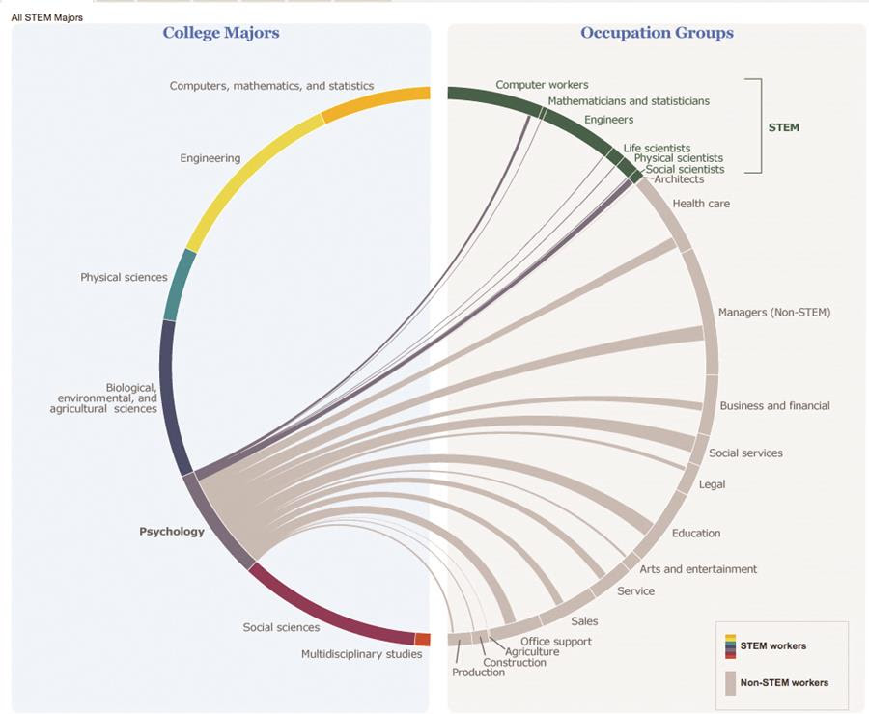
Careers in Psychology

