Slide 1
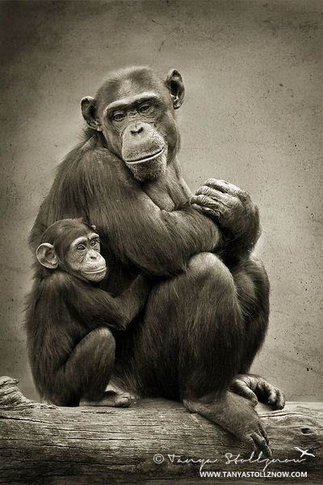
Attachment

Slide 2
Stages in the Formation of Human Attachment
First two months of life
Nonselective sociability
About two months of age
Clear preference for familiar others
About six months of age
Separation anxiety & fear of strangers
By two years
Clear, powerful attachment to individual, especially mother
By three years
Can tolerate periods of mother absence & temporary partnerships with others

Slide 3
Attachment Theory (John Bowlby & Mary Ainsworth were the pioneers of this research)
Measured in infants with the “Strange Situation”
Measured in adults with the “Adult Attachment Interview” (AAI)
There are also a variety of Questionnaire measures of attachment for adults.

Slide 4
Attachment Styles in Children
Strange Situation
Secure Attachment: (about 60-70% of American Kids)
- actively plays and explores, uses mother as a secure base
- distressed when mother leaves, pleased when mother returns; easily comforted following separation
- more direct contact with mother following separation
Avoidant or Anxious-Avoidant: (About 20% of American Kids)
- little attachment to mother (may even be friendlier to stranger)
- little separation distress, may avoid mom during reunions
- most likely to display anger
Ambivalent or Anxious-Resistant (About 10% of American kids)
- do not explore much; sticks close to mom
- intensely upset by separation; angrily resists contact during reunions
Disorganized - Disoriented
- most insecure style; very confused/contradictory reunification responses
- usually occurs only in seriously dysfunctional families

Slide 5
Variables Related to Attachment Style
Amount of physical contact between mother and child
How encouraging and stimulating is the mother?
How often are positive feelings directed toward the child?
How good is the mother at calming/soothing the child?
How well does the mother’s parenting style match the needs of the infant?

Slide 6
Attachment Styles in Adults
Secure
Anxious-Preoccupied
Likes intimacy, But fears rejection. Worrier!
Dismissive-Avoidant
Independent; does not desire intimacy
Fearful-Avoidant
Wants intimacy, but lacking in trust

Slide 7
Consequences of Attachment Style
Securely attached kids:
Decreased negative emotions at 2-3
Cooperate better with parents
More obedient
Adapt better to preschool
Get positive responses from peers
Longer, happier marriages; closer friendships
Insecurely attached kids:
Exploitative, unstable, opportunistic adult relationships
Insecure avoidant date more, more sex without love
Two insecurely attached people = high conflict marriage

